Slide 1
Introduction to Gatke Phenolic Bearings and Laminates
Chris Koralik
Kor-Pak Corporation

Slide 2
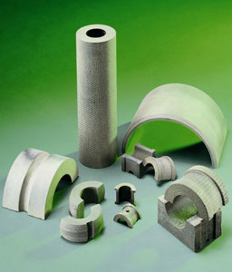
What is Gatke?
Impregnated, self-lubricating Phenolic Bearings and Laminates made from raw molded tube
Made of high-strength fabrics and special long-lasting resin compounds
Various Grades of Gatke materials suitable for different applications
Ubiquitous usage to permeate multiple industries and applications
Highly durable product that is superior to its competitors in terms of forgiveness, heat and pressure resistance, and capable of enduring shocks and heavy loads

Slide 3
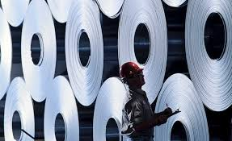
Where is Gatke Used?
Mill Applications (i.e. Roll Stands)
Construction (i.e. Pivot Point)
Rail (Center Plates, Vertical Liners, Wear Plates, Equalizer Seats, Traction Bearings, Bushings
Water Treatment (Agitator Tanks)
Screw Conveyor
Agriculture, Mining, and Energy (hanger bearings, bushings, drilling equipment, bearings, etc.)

Slide 4
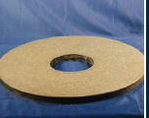
More about Gatke Products
Spherical Bearings: Ideal for self-aligning applications on construction machinery, machine tools, pulverizing equipment and other high wear or tough applications. Chemical Resistant Bearings: Specific formulations of molded fabric-reinforced, phenolic materials are available to withstand acids, alkalis and solvents. Ideal for chemical processing equipment.
Wear Plates: A wide variety of special wear plates are available Slipper Bearings: All types for eliminating scoring, absorbing shocks and reducing noise. Will far outlast metal.

Slide 5
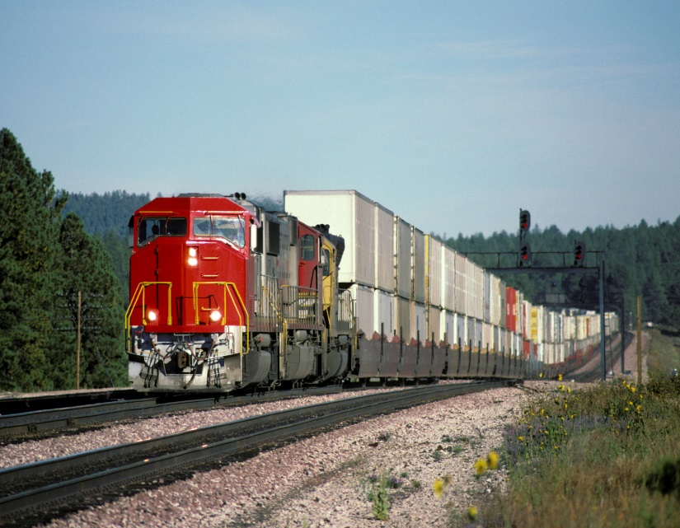
More About Gatke (cont.)
All Shapes and sizes
--Flat profile parts 30” wide up to 10’ Long
-- Wear Pads
--Electrical Mounting Surfaces
Round Bearings, bushings, half bushings, flange bushings in sizes from .75” to 8’ in diameter
Material Performance Comparison
Wood—3 month Usage
Bronze—Approximately 1 year ( must have lubrication)
Gatke Phenolic Bearings—About 2 to 3 years with self lubrication

Slide 6
Who does Gatke Compete With and How Does it Compare?
Materials | Cost Difference | Advantages | Disadvantages
Babbitt | +75 to 100% | Old worn or misaligned equipment | Lead-based, need for a casting, & machining – environmental concerns
UHMW | - 50% | Lower Price | Can’t take more than 250 degrees F
Bronze | + 0 to 25% | Accepted technology – easy to machine – been around for a long period of time | Three times heavier than Gatke – permanent deformation – environmental concerns
Steel | - 25% | Good heat resistance | Very aggressive wear on shaft & galling
Other Phenolics | +/- 10% | More cost effective in smaller diameters – sizing in some instances | Size limitations – we can produce larger diameters

Slide 7
Custom Gatke Phenolics and Laminates
We solve problems where:
--Custom product design is needed
--Lubrication--availability of lubrication & temperature are problematic
--Environment Hazard
--Maintenance Problems
Bronze doesn’t work or Thermoplastics fail
Grit and Dust Destroy Metal Bearings
Chemical solutions destroy metal bearings

Slide 8
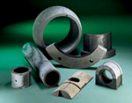
Let Kor-Pak Provide You With the Phenolic/Laminates You Need
Call 1-888-2KorPak or e-mail sales@kor-pak.com for more information
Gatke samples available upon request

