Slide 1

Technical Training Program on IMPULSE AC Drives
Chris Koralik
Kor-Pak Corporation
Notes:
Welcome to Magnetek Material Handling & Kor-Pak Corporation
Welcome to Magnetek Material Handling’s Technical Training Program.
This training program has been specifically designed to provide information regarding the application, use and troubleshooting of the IMPULSE G+ Mini and the IMPULSE G+/VG+ Series 4 AC drives.
If you should have any questions during this three-day training session, please ask your instructor.

Slide 2

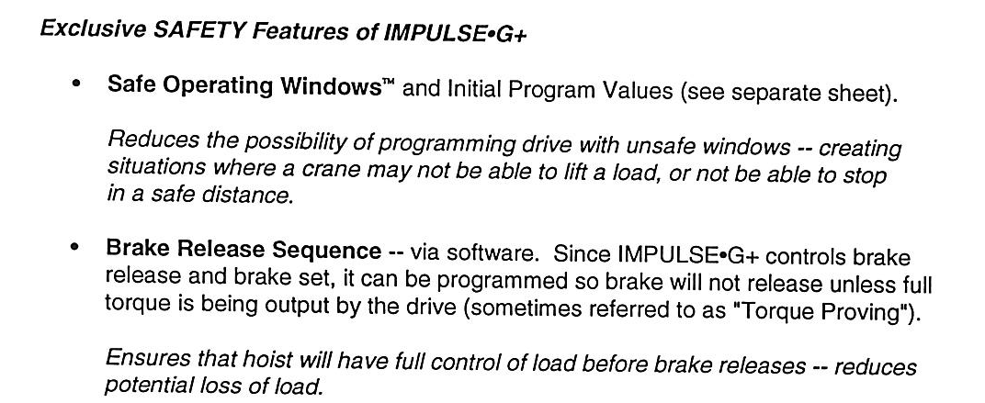
Impulse Drives: Safety Features

Slide 3
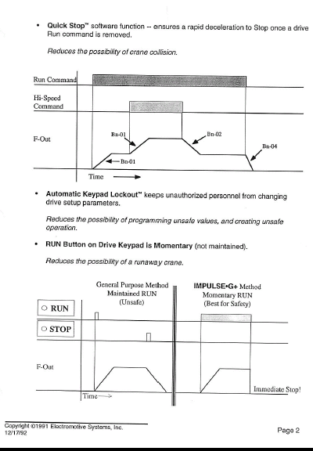

Slide 4
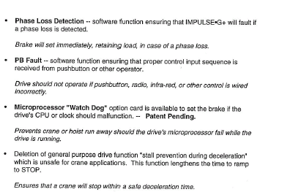
Impulse Drives: Safety Features

Slide 5
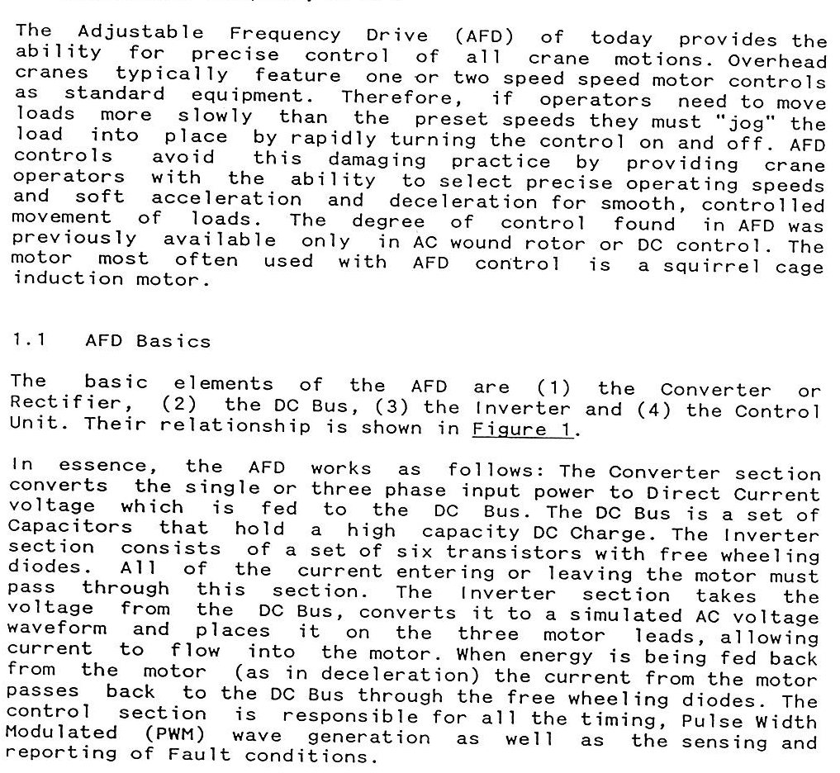

Slide 6
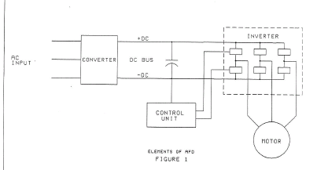
Diagram of VFD Process

Slide 7
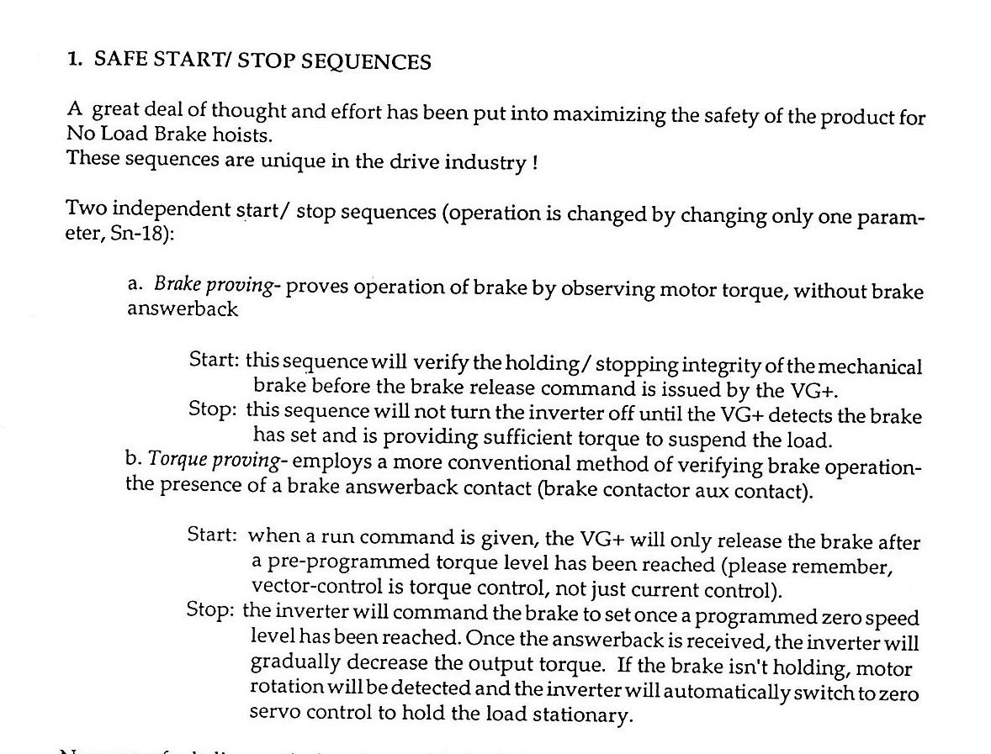

Slide 8
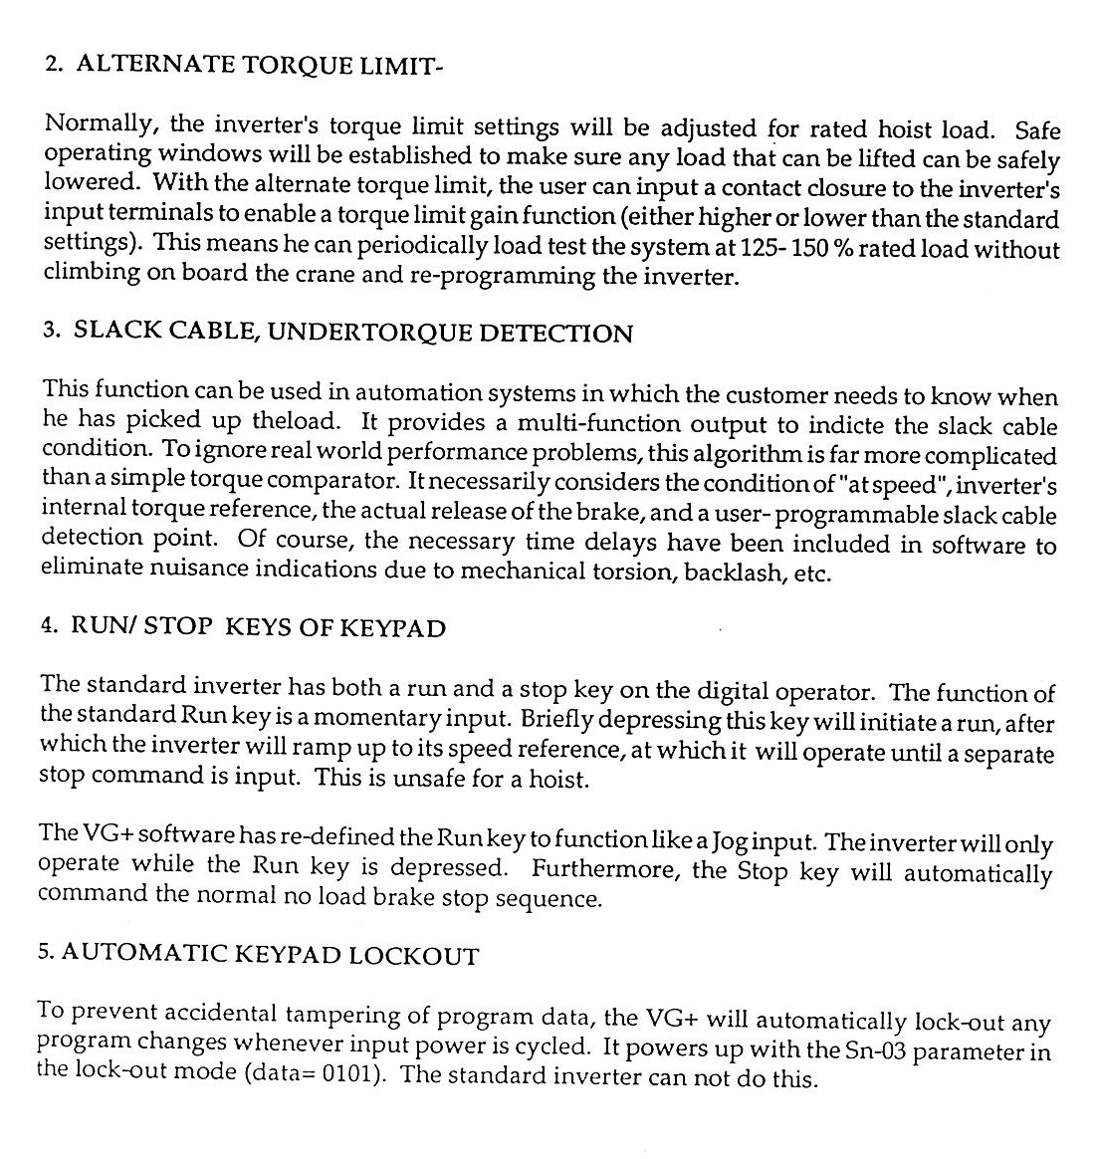

Slide 9
Impulse Drives: Safety Features

Slide 10
Impulse Drives: Safety Features

Slide 12
Impulse Drives: Safety Features

Slide 14
Diagram of VFD Process

Slide 17
IMPULSE® Drives
Section B will include
  Terms associated with IMPULSE drives in overhead crane applications
  Basic theory of IMPULSE AC Adjustable Frequency Drives
  Programming of IMPULSE®•G+ Mini and IMPULSE®•G+/VG+ Series 4 drives
  Trouble shooting of IMPULSE®•G+ Mini and IMPULSE®•G+/VG+ Series 4 drives
Notes:
Material to be covered in section B

Slide 18
IMPULSE Drives
Application Questionnaire
  Hoist Manufacturer
  Motor Data
  Special Motor Type
  Brake Type
  Facility Data
  New or Existing Application
  Equipment Data
  Other Options Required
Notes:
An application “Questionnaire” is useful for both determining requirements for a new application as well as troubleshooting. For new applications, use of this questionnaire guarantees the proper drive is chosen for the specific application. For troubleshooting, it helps one to determine the application the drive is being used in.

Slide 19
IMPULSE Drives
CMAA Crane Classification
  Class A – Standby/Infrequent Service
  Class B – Light Service
  Class C – Moderate Service
Notes:
CMAA Crane Classification Definitions
Class A (Standby or Infrequent Service)
This service class covers cranes which may be used in installations such as powerhouses, public utilities, turbine rooms, motor rooms, and transformer stations where precise handling of equipment at slow speeds with long, idle periods between lifts are required. Capacity loads may be handled for initial installation of equipment and for infrequent maintenance.
Class B (Light Service)
This service covers cranes which may be used in repair shops, light assembly operations, service buildings, light warehousing, etc., where service requirements are light and the speed is slow. Loads may vary from no load to occasional full rated loads with two to five lifts per hour, averaging ten feet per lift.
Class C (Moderate Service)
This service covers cranes which may be used in machine shops or paper mill machine rooms, etc., where service requirements are moderate. In this type of service the crane will handle loads which average 50 percent of the rated capacity with five to 10 lifts per hour, but not over 50 percent of the lifts at rated capacity.

Slide 20
IMPULSE Drives
CMAA Crane Classification
  Class D – Heavy Service
  Class E – Severe Service
  Class F – Continuous Severe Duty
Notes:
CMAA Crane Classification Definitions (continued)
Class D (Heavy Service)
This service covers cranes which may be used in heavy machine shops, foundries, fabricating plants, steel warehouses, container yards, lumber mills, etc.; standard duty bucket and magnet operations where heavy duty production is required. In this type of service, loads approaching 50 percent of the rated capacity will be handled constantly during the working period. High speeds are desirable for this type of service with 10 to 20 lifts per hour averaging 15 feet, but not over 65 percent of the lifts at rated capacity.
Class E (Severe Service)
This type of service requires a crane capable of handling loads approaching a rated capacity throughout its life. Applications may include magnet, bucket, magnet/bucket combination cranes for scrap yards, cement mills, lumber mills, fertilizer plants, container handling, etc. with twenty or more lifts per hour at or near the rated capacity.
Class F (Continuous Severe Service)
This type of service requires a crane capable of handling loads approaching rated capacity continuously under severe service conditions throughout its life. Applications may include custom designed specialty cranes essential to performing the critical work tasks affecting the total production facility. These cranes must provide the highest reliability with special attention to ease of maintenance features.

Slide 21
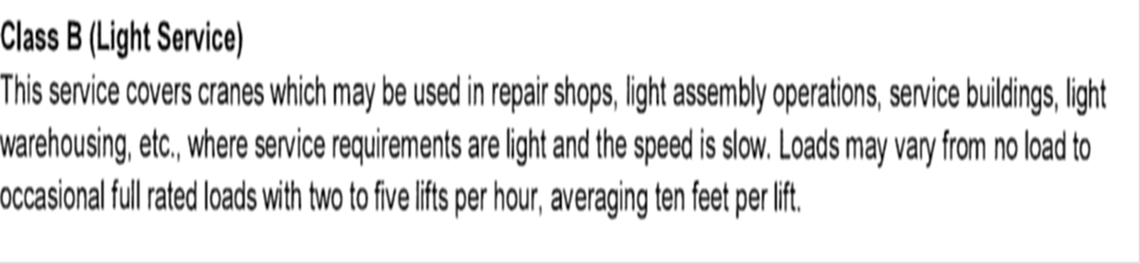
IMPULSE Drives
CMAA Crane Classifications Class A and B
Class A (standby or Infrequent Ser
Notes:
Definition of CMAA class C application
Magnetek will supply class ”C” dynamic braking circuitry in most CMAA class A and B applications
NOTE – exception is taken to class C dynamic braking circuitry for No Load Brake Hoist motions in power house, turbine maintenance types of applications. A unique sizing of dynamic braking circuitry is required, the dynamic braking circuitry will be sized based on motor design and Full Load Amperage as well as length of travel and hoist speed

Slide 22
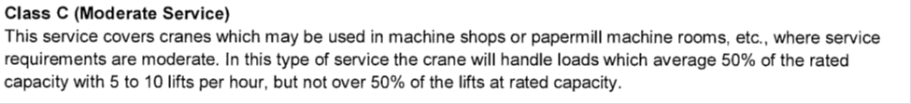
IMPULSE Drives
CMAA Crane Classifications Class C
Notes:
Definition of CMAA class C application
Magnetek will supply class ”C” dynamic braking circuitry in these applications

Slide 23
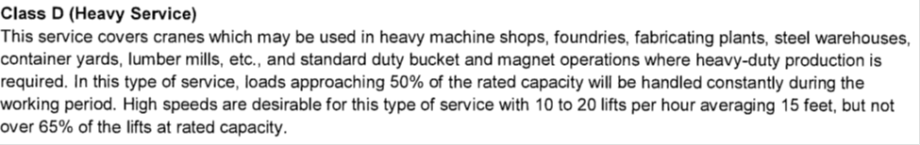
IMPULSE Drives
CMAA Crane Classifications Class D
Notes:
Definition of CMAA class D application
Hoists in class D applications may or may not have a Mechanical Load Brake
Magnetek will furnish class “D” rated dynamic braking circuitry for traverse motions and No Load Brake hoist motions, but for Mechanical Load Brake motions class “C” traverse motion dynamic braking circuitry is used

Slide 24
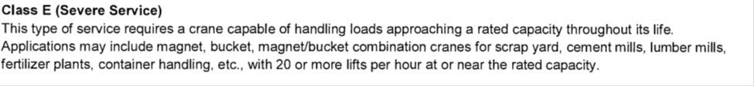
IMPULSE Drives
CMAA Crane Classifications Class E
Notes:
Definition of CMAA class E application
It is typical that all hoists in class E applications are a No Load Brake design.
Magnetek will furnish class “E” rated dynamic braking circuitry

Slide 25
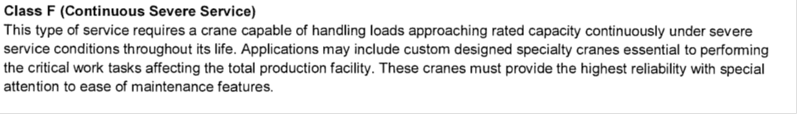
IMPULSE Drives
CMAA Crane Classifications Class F
Notes:
Definition of CMAA class F application
It is typical that all hoists in class F applications are a No Load Brake design.
Magnetek will furnish class “F” rated dynamic braking circuitry

Slide 26
IMPULSE Drives
HMI Classification
  H1 – Infrequent Service or Standby
  H2 – Light
  H3 – Standard
  H4 – Heavy
  H5 - Severe
Notes:
HMI – Hoist Duty Service Classification
H1 – Infrequent or Standby
Powerhouse and utilities, infrequent handling. Hoists used primarily to install and service heavy equipment where loads frequently approach hoist capacity with periods of utilization being infrequent and widely scattered.
H2 – Light
Light machine shop, fabricating industries, service and maintenance work where loads and utilization are randomly distributed with capacity loads infrequently handled, and where total running time of equipment does not exceed 10-15% of the work period.
H3 – Standard
General machine shop, fabricating, assembly, storage and warehousing where loads and utilization are randomly distributed with total running time of equipment not exceeding 15-25% of the work period.

Slide 27
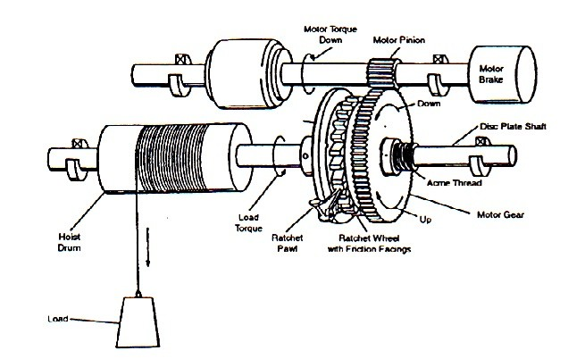
IMPULSE Drives
Mechanical Load Brake Hoists
Notes:
Simplified representation of a mechanical load brake hoist

Slide 28
IMPULSE Drives
Mechanical Load Brake Hoists
  Defined by CMAA as a hoist control braking means
  Controls load during lowering
  Keeps load from falling if motor brake fails
  Supplements the electric motor brake
Notes:
Mechanical Load Brake Hoists
Function
The mechanical load brake is defined by CMAA as a hoist control braking means. It is an integral part of the hoist gear train. Its purpose is to control the load during lowering and to keep the load from falling if the motor brake fails. The mechanical load brake supplements the electric motor brake.
A typical ratchet and pawl type mechanical load brake is shown on the previous page. Note that the ratchet wheel has two friction faces. It is free to rotate on the hub of the motor gear, but can rotate only in the up direction since the ratcheted pawl locks it to prevent rotation in the down direction. The motor gear is not keyed to the disc plate shaft, but transmits its torque through the acme thread on the shaft. Action of the screw thread causes an axial movement of the motor gear which engages and disengages the friction surfaces on the ratchet wheel, depending on the relative speed and direction of the rotation of the motor gear and disc shaft. Some mechanical load brake designs make use of over-running clutches in lieu of ratchets and pawls, but regardless of which type of mechanism is used, the function is the same.
In operation, the mechanical load brake serves a dual function. It acts as a brake in slowing or stopping a load. But during the lowering operation, it also serves as a clutch by providing control over the rate of load descent.

Slide 29
IMPULSE Drives
Mechanical Load Brake Hoists
  Applying IMPULSE Drives
    Use the standard hoist amp-acity rating when selecting a drive
    Due to wear of the mechanical load brake, hoists require dynamic braking resistors
Notes:
Mechanical Load Brake Hoists
Applying IMPULSE Drives
1. When selecting a drive, use the standard hoist amp-acity rating (constant torque rating). Drives need not be oversized for class of service.
2. Most hoists with mechanical load brakes do require dynamic braking resistors. Experience has shown that all hoists eventually, due to wear of the mechanical load brake, require dynamic braking resistors. They are sized for approximately 50% braking torque.
Because of the wear and lack of maintenance associated with mechanical load brakes under heavy duty service, some load brakes will slip in time causing a loss in operating performance. In these instances, adding dynamic braking resistors serve as a wear indicator in that when OV faults occur, the mechanical load brake is not functioning properly and needs maintenance.
Some new hoists may also require dynamic braking resistors to avoid nuisance OV trips caused by minor slippage in the mechanical load brake when changes in speed or load occur. Speeds below 6Hz will not be possible.

Slide 30
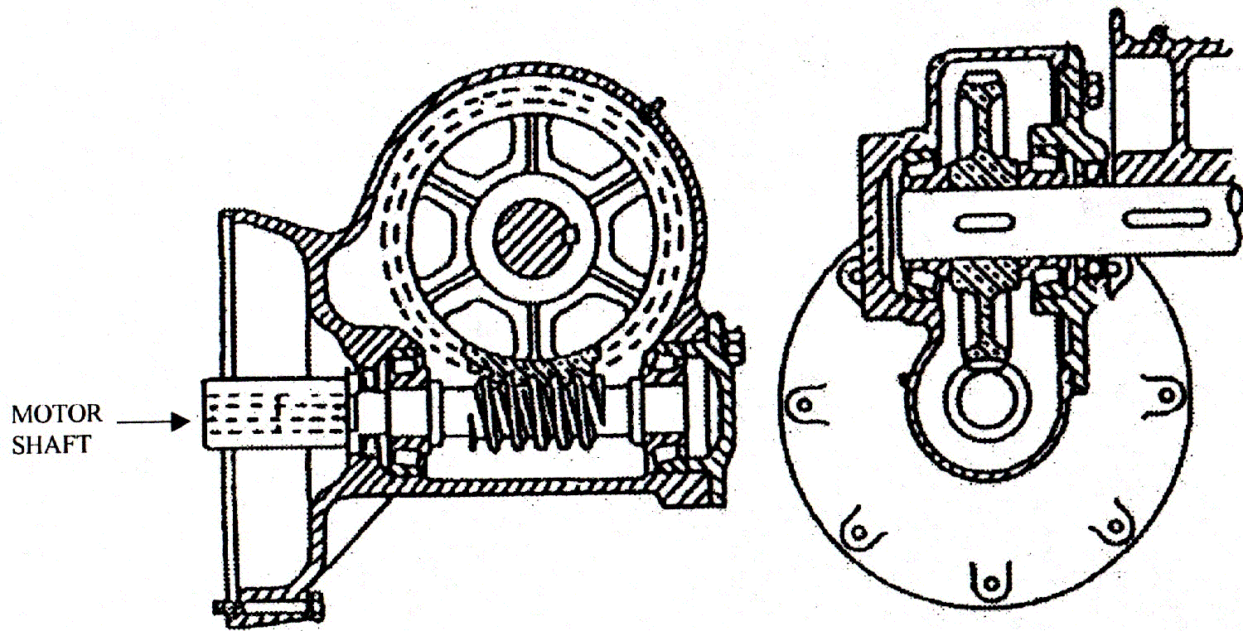
IMPULSE Drives
Worm Gear Hoists
Notes:
Worm Gear hoist

Slide 31
IMPULSE Drive
Worm Gear Hoists
  Considered by CMAA to be equipped with a controlled braking means
  Common misconception that all worm gears are self-locking or non-overhauling
Notes:
Worm Gear Hoists
Function
Worm gear hoists, the angle of whose worm is such as to prevent the load from accelerating in the lowering direction, are considered by CMAA to be equipped with a controlled braking means.
It is a common misconception that all worm gears are self-locking or non-overhauling. Actually, worm gear ratios up to 15:1 will overhaul quite freely. Ratios from 20:1 to 40:1 can generally be considered self-locking, but these may or may not overhaul depending on loading, lubrication and the amount of vibration present.
Self-locking ratios (generally 40:1 and higher) are susceptible to the phenomenon of stair-stepping when overhauling. Stair-stepping, an erratic rotation of the gear set, occasionally occurs when the gear set is back-driven at worm speeds less than the theoretical lock-up speed of the gear set. This condition can occur on hoists where there is a high inertial load at the output shaft.

Slide 32
IMPULSE Drives
Worm Gear Hoists
Applying IMPULSE drives
  Dynamic braking resistors should be used
  on all worm gear hoists
  Extremely slow speeds may not be achievable
  Program IMPULSE•G+ Series 4 and IMPULSE•G+ Mini to overcome lockup at start (voltage boost)
Notes:
Worm Gear Hoists
Applying IMPULSE Drives
1. Dynamic braking resistors should be used on all worm gear hoists.
2. Because of the tendency for some worm gears to stair-step at very slow speeds, extremely slow speeds (< 6.0 Hz for NEMA B, or < 10 Hz for NEMA D) may not be achievable.
3. Program IMPULSE drive to provide a momentary current boost at “Start” to provide sufficient torque to overcome lockup.

Slide 33
IMPULSE Drives
Special Input Power Supplies
  575 Volt AC (G+/VG+ Series 4)
  250 Volt DC
  Single-Phase
  25 Hertz
Notes:
Special Input Power Supplies
Most industrial facilities will have either 230 or 460 VAC, three-phase and 50 or 60 Hz input power on their mainline runway conductors. The following unusual voltages are sometimes encountered:
575 Volt AC
575 VAC is common in Canada as well as textile mills in southeastern United States and other locations in the northeastern United States along the Canadian border.
250 Volt DC
DC voltages of 250 VDC can be used as a supply for 200V series IMPULSE drives. The input voltage must be a minimum of 250 VDC and must be regulated. However, the output voltage from the drive to the motor will only be about 176 VAC. To obtain full torque at 100% speed, a special motor will be required. On traverse applications, a standard 208 VAC motor will typically be suitable.

Slide 34
IMPULSE Drives
Recommended Motor Features
  Standard Duty
    Squirrel Cage Motor
    NEMA Design B (3 to 5% Slip)
    TENV Enclosure Design
    60-Minute Time Rating
    Class F Insulation
    Thermostats (Klixons in Stator Windings)
Notes:
Recommended New Motor Characteristics for Standard Duty Crane/Hoist Applications
1. Squirrel Cage Motor
2. NEMA Design B (3 to 5% Slip)
3. TENV Enclosure Design
4. 60-Minute Time Rating
5. Class F Insulation
6. Thermostats (Klixons in Stator Windings)

Slide 35
IMPULSE Drives
Recommended Motor Features
  Standard Duty – CMAA C and D applications
    Squirrel Cage Motor
    NEMA Design B (3 to 5% Slip)
    TENV Enclosure Design
    60-Minute Time Rating
    Class F Insulation
    Thermostats (Klixons in Stator Windings)
Notes:
Recommended New Motor Characteristics for Standard Duty Crane/Hoist Applications
1. Squirrel Cage Motor
2. NEMA Design B (3 to 5% Slip)
3. TENV Enclosure Design
4. 60-Minute Time Rating
5. Class F Insulation
6. Thermostats (Klixons in Stator Windings)

Slide 36
IMPULSE Drives
Recommended Motor Features
  Special Duty CMAA class C, D and E applications
    All standard duty features
    1.0 Service Factor on AFD Power
    Temperature rise over ambient rating of class F (115° C)
Notes:
Inverter Duty Motor Characteristics for Special Duty Crane/Hoist Applications
1. Standard Duty Recommendations
2. 1.0 Service Factor on AFD Power, 1.15 Service Factor on Sine Wave Power
3. Temperature Rise over Ambient Rating of Class F (115º)

Slide 37
IMPULSE Drives
Applications Requiring Inverter Duty Motors
  Special Duty CMAA class E and F applications
    Low speed (3 to 6 hz) operation for extended periods of time
    Very low speed (1.5 hz) operation w/100% motor torque, smooth shaft rotation
    CMAA class E or F cranes
    High ambient temperature environments
Notes:
Applications Which Would Involve or Require Inverter Duty Motors
1. Low Speed (3 to 6 Hz) Operation for Extended Periods of Time
2. Very Low Speed Operation (1.5 Hz) with 100% Motor Torque and Smooth Shaft Rotation
3. CMAA Class E or F Cranes
4. High Ambient Temperature Environments

Slide 38
IMPULSE Drives
Applications that may require “severe duty treatment”
  TEBC construction or upsize frame
  Class H insulation
  Special pain coatings and shaft seals
Notes:
Severe Duty Applications May Require
1. TEBC construction or upsize of motor frame
2. Class H Insulation mandatory
3. Special paint / coatings and shaft seals (bearing isolators)

Slide 39
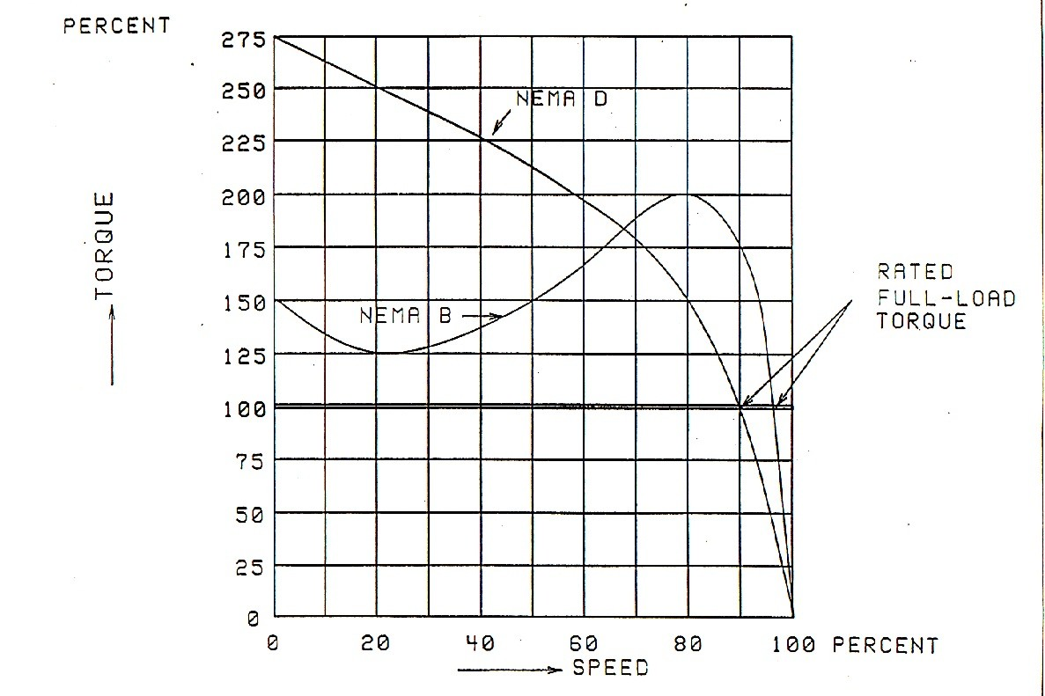
IMPULSE Drives
Applying NEMA D Motors
Notes:
NEMA D Motors
NEMA Design D motors were commonly used in the past and can be found today on hoist motions with reversing contactor controls because of their high starting torque (up to 325% motor rated torque = 325% motor nameplate FLA). NEMA D motors also have a high slip (5 to 13%) which results in a lower speed ratio. A high starting torque is not required nor used on inverter controls because the drive varies the voltage and frequency to give a soft-start even on hoist applications.
IMPULSE•G+ Series 4 can be used with NEMA D motors for hoist applications with mechanical load brakes or worm gear boxes. IMPULSE•VG+ Series 4 can also be used for hoists without mechanical load brakes. NEMA Design D motors with slips greater than 8% may be used with IMPULSE•G+ Series 4, but may be compatible with IMPULSE•VG+ Series 4. However, some speed regulation capability will be lost. Individual selected speeds will vary somewhat between a light load and a full capacity load. The speed regulation capabilities of IMPULSE•G+ Mini when used with NEMA D motors, may be only between 12:1 and 6:1 depending upon the amount of slip and nature of the hoist gear train. The negative effects of using a high slip motor can be reduced somewhat by using the Slip Compensation feature of IMPULSE drives.

Slide 40
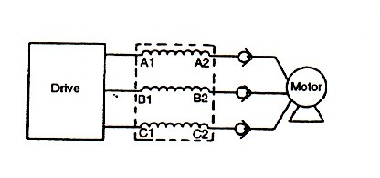
IMPULSE Drives
Applying Wound Rotor Motor
Notes:
Wound Rotor Motors
Wound rotor motors had been common place in the crane and hoist industry. When their secondary winding slip rings are shorted, their speed/torque curve is very similar to that of a NEMA Design A motor with very little slip. Consequently, they are ideal for adjustable frequency drives.
Shorting the primary windings of a wound rotor motor characteristically results in the modified wound rotor motor having a lower impedance than a typical inverter duty motor. Placing a “load” reactor of 3% impedance between the output of an IMPULSE drive and converted wound rotor motor should result in an impendance that closely matches an inverter duty motor.
When shorting the secondary winding of a wound rotor motor, we recommend brazing copper bars across all three rings adjacent to the wire leads. If the rotor has multiple sets of leads going to the slip rings, use multiple bars of copper equally spaced around the rings.

Slide 41
IMPULSE Drives
Applying IMPULSE Drives to Existing Motors
  Two-Speed/Two-Winding
  Consequent Pole Motors
  Single-Phase Motors
Notes:
Applying IMPULSE Drives for Use with Existing Motors
Two-speed, two-winding squirrel cage motors are commonly used on hoists, trolleys and bridges for two-step speed regulation. IMPULSE drives can be wired to either the low-speed winding or high-speed winding and still provide greatly enhanced speed regulation and smooth control. Beware of the higher amperages associated with two-speed/two-winding motors when sizing IMPULSE drives. The low-speed motor windings are normally rated for 15 minute duty. In addition, because of the poor power factor characteristics associated with two-speed/two-winding motors (especially in the low-speed windings), the available speed range will only be in the area of between 6:1 and 10:1 depending upon the nature of the motor and gear train.
Consequent pole multi-speed (multi-pole) motors are sometimes used on crane applications. The motor design and the contactor control scheme are more complicated than standard multi-winding motors. In this case, the low-speed wires (T1, T2 and T3) must be shorted together and the IMPULSE drive wired into the high-speed wires (T4, T5 and T6).
Single-phase motors cannot be operated by an IMPULSE drive. If the motor uses a capacitor for starting, the capacitor will probably be damaged due to the high harmonic current flow. Single-phase motors typically use a separate start-and-run winding. When the motor reaches a preset speed, a centrifugal switch opens and de-energizes the start winding. Because of the slow, smooth starting of an IMPULSE drive, the switch will not open and the start-winding may burn out.

Slide 42
IMPULSE Drives
Selecting Line/Load Reactors
  Line reactors
    Acts as a current limiting device
    Filters the waveform and attenuates electrical noise associated with AFD output
    Use continuous output rating of the drive when selecting line reactors
Notes:
Selecting Line/Load Reactors
Three-phase line reactors offer an economical solution to a variety of application problems associated with adjustable frequency drives. Reactors can be used to solve problems on either the input or the output side of the drive. The line/load reactors supplied by Electromotive Systems have been selected specifically for use with AFDs. They have a 3% impedance rating.
Line Reactors
The line reactor acts as a current limiting device, filters the waveform and attenuates electrical noise associated with the AFD output. In this respect, the line reactor even surpasses the isolation transformer. On the line side of the AFD, reactors serve a bi-directional function. The properly applied impedance reactor minimizes nuisance tripping of drives caused by voltage spikes. Also, the reactor can protect from line sags because it performs a line stabilizing function. Looking on the line side from the opposite direction, the reactor filters out both pulsed and notched distortion. This minimizes interference with other sensitive electronic equipment, such as other AFDs, Material Handling, PLCs, telecommunications systems, etc.
When selecting line reactors, use the continuous output ampere rating of the drive.

Slide 43
IMPULSE Drives
Selecting Line/Load Reactors
  Load reactors
    Used on the load side of the AFD between AFD and motor
    Protects the drive under motor short circuit conditions
    Reactor attempts to recreate perfect sine wave, improves motor efficiency
    Use the full load ampere rating of the motor when selecting load reactors
Notes:
Load Reactors
The load reactor is used on the load side of the AFD between the AFD and the motor. It functions as a current limiting device to provide protection for the drive under motor short-circuit conditions. In this respect, the load reactor slows the rate of rise of the short-circuit current and limits the current to a safe value. By slowing the rate of current rise, the reactor allows ample time for the drive’s own protective circuits to react to the short circuit and trip out safely. Also, the reactor absorbs surges created by the motor load that might otherwise cause nuisance tripping of the drive. The reactor attempts to recreate a perfect sine wave, thus improving motor efficiency.
When selecting load reactors, use the full load ampere rating of the motor. Load reactors need to be applied when using a wound rotor motor.

Slide 44
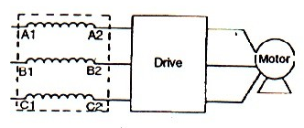
IMPULSE Drives
Input to Single AFD
Notes:
Input to Single AFD
On the input side of an IMPULSE AFD, line reactors protect sensitive electronic equipment from electrical noise created by the drive (notching, pulsed distortion, harmonics, etc.). They also protect the AFD from surges or spikes on the incoming power lines, as well as reduce harmonic distortion.

Slide 45
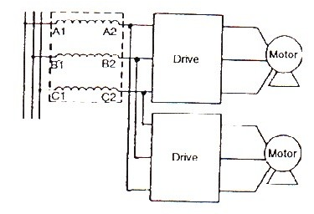
IMPULSE Drives
Input to Multiple AFDs
Notes:
Input to Multiple AFDs
In certain applications, a single reactor may be used to serve multiple adjustable frequency drives provided drives are of exact same type on same motion. But the preferred method is to use a single reactor per drive.

Slide 46
IMPULSE Drives
IMPULSE Controls Advantages
  Variable speed control w/single-speed motor
  Minimizes high-starting current w/motor
  Adjust acceleration/deceleration rates
  Unique torque limit function
  Creep speed for precise positioning without plugging
  Can produce 150% full load torque
Notes:
IMPULSE Controls ~ Advantages
Infinitely variable speed control can be accomplished using a standard, low-cost, single-speed AC squirrel cage induction motor in place of more expensive multi-speed or wound rotor motors.
IMPULSE crane controls minimize the typically high starting in-rush current and drastically decreases the shock effect on both the load and the equipment. This ensures a smooth movement of the load and extends equipment life.
Independently adjustable acceleration and deceleration rates and a unique torque limit function IMPULSE•G+ Mini and IMPULSE•G+ Series 4 in open loop vector mode and IMPULSE•VG+ Series 4 provide a cushioned, soft-start and stop. This guarantees controlled, accurate load movements and eliminates the need to jog or reverse plug the motor.
Delicate loads can be positioned with precision creep speeds without the need for costly micro-speed motors or plugging motor controls.
With IMPULSE crane controls, AC motors can produce up to 150% full load torque at all motor speeds.

Slide 47
IMPULSE Drives
IMPULSE Controls Advantages
  Inverter output frequencies > 60hz are possible
  Retrofit existing AC equipment
Notes:
IMPULSE Controls ~ Advantages
Inverter output frequencies greater than 60 Hertz are possible when over-speeding of the motor is applicable.
IMPULSE controls can be retrofitted to existing AC equipment. Single-speed, two-speed or wound rotor motors can easily be converted into high performance, variable speed motors.

Slide 48
IMPULSE Drives
IMPULSE Controls Advantages
  Lowers operating costs and minimizes equipment downtime
    AC squirrel cage induction motors for variable
    speed control provide reliability
    Electronic reversing, multi-speed operation eliminates conventional magnetic contactors
    Electronic dynamic braking provides effective
    braking without the use of mechanical brakes
Notes:
IMPULSE Controls Advantages
IMPULSE controls lower operating costs and minimize equipment downtime.
AC squirrel cage induction motors for variable speed control provide rugged, reliable, practically maintenance-free operation.
Electronic reversing and multi-speed operation eliminate conventional magnetic contactors and their frequent maintenance.
Electronic dynamic braking provides effective braking of the load without the use of mechanical brakes. This eliminates repetitive adjustments and dramatically reduces brake wear. This electro/mechanical brake acts only as a parking brake, setting after the motion has come to rest (for traverse motions).

Slide 49
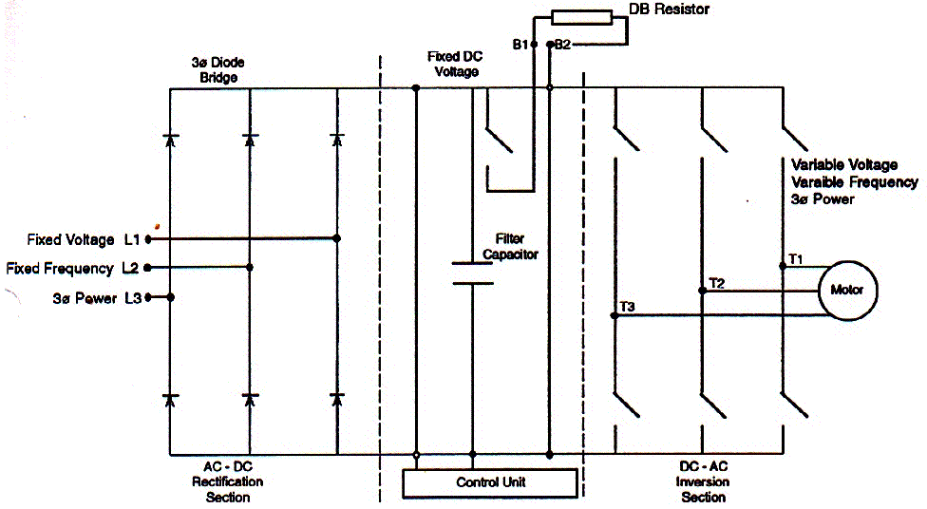
IMPULSE Drives
PWM Inverter
Notes:
Simplified diagram of IMPULSE drive power section.

Slide 50
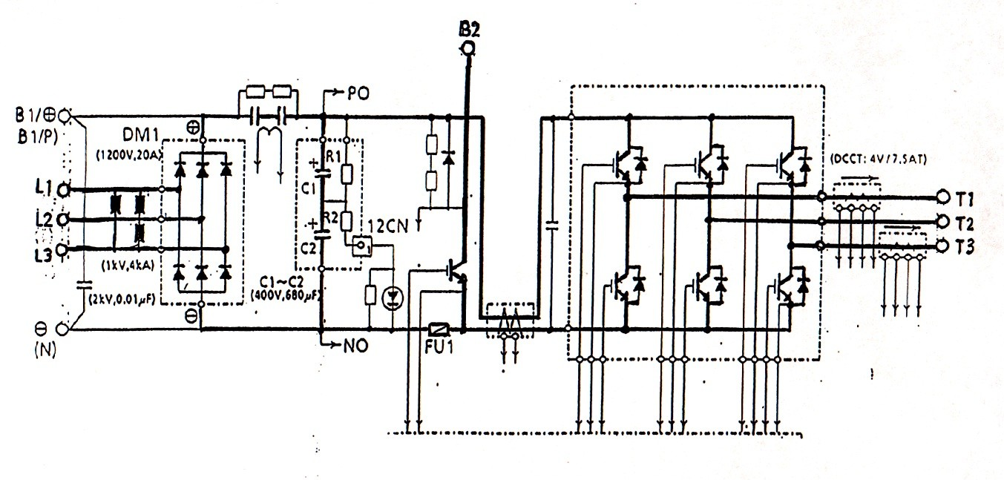
IMPULSE Drives
PWM Inverter
Notes:
Actual diagram of early version “S” Series drive platform.

Slide 51
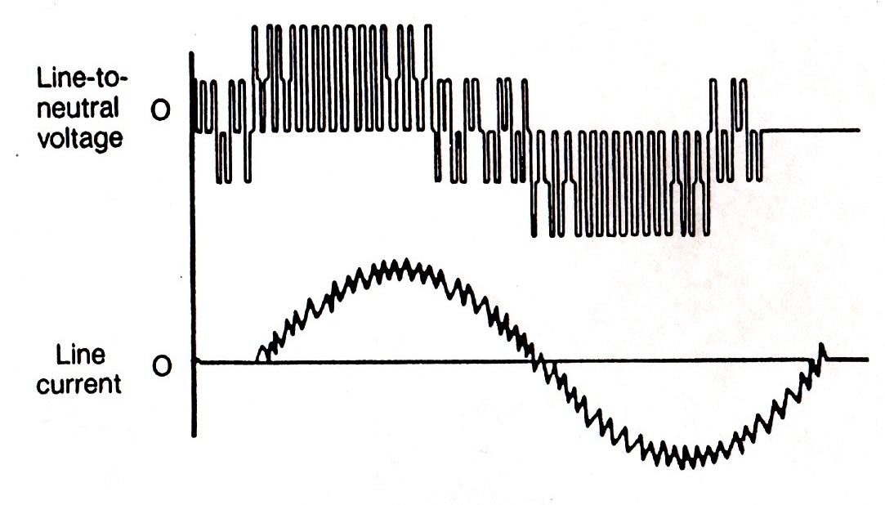
IMPULSE Drives
PWM Waveforms

Slide 52
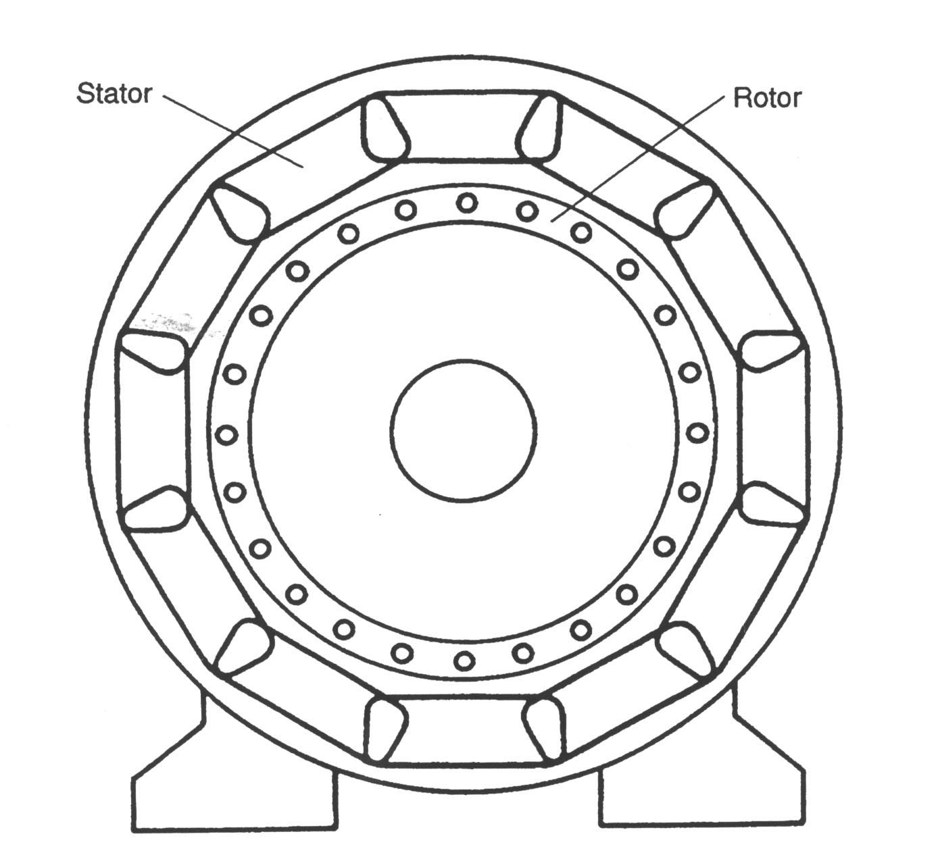
IMPULSE Drives
3Ø AC Motors
Notes:
Basic design of squirrel cage induction motor

Slide 53
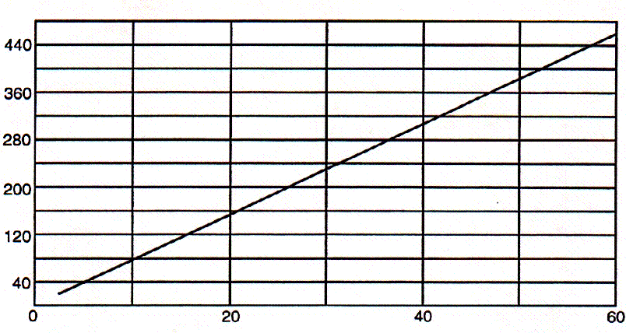
IMPULSE Drives
V/F Ratio
Notes:
Maintaining the ratio of 460V / 60 Hz provides resulting current needed to produce motor rated torque at various output frequencies

Slide 54
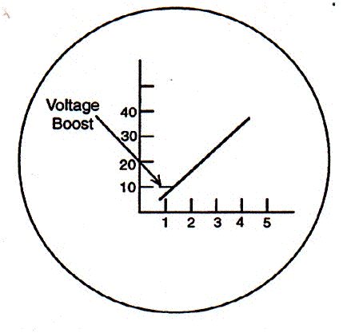
IMPULSE Drives
Theoretical V/F Ratio w/Voltage Boost
Notes:
Diagram represents the “theoretical” voltage boost at low output frequencies

Slide 55
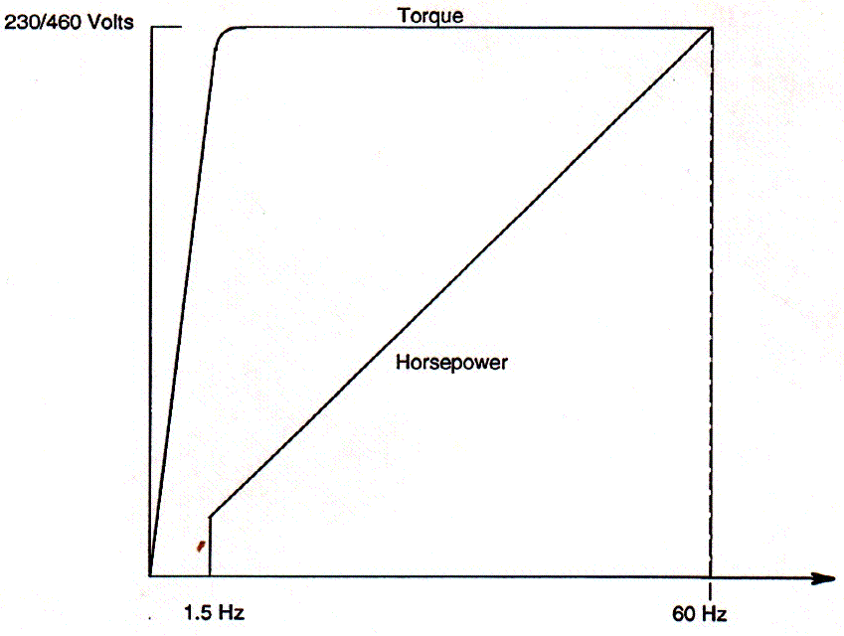
IMPULSE Drives
V/F Curve
Notes:
Diagram represents the “speed / torque” of a motor through the available motor speed range when using an IMPULSE drive
NOTE - diagram shows speed/torque for the V/F control mode with the published “40:1 Output Speed Control Range” for IMPULSE G+ Mini and G+ Series 4 drives

Slide 56
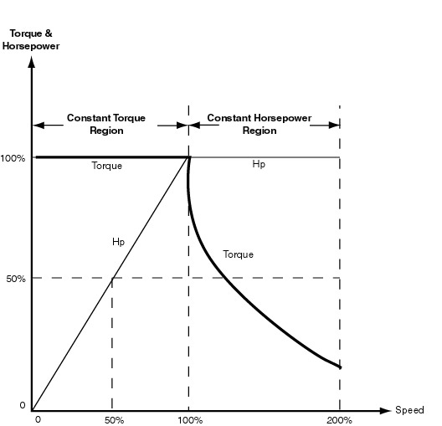
IMPULSE Drives
Torque & Horsepower vs. Speed
Notes:
It is important to note that motor torque decreases exponentially when motor shaft speed exceeds motor rated synchronous speed

Slide 57
IMPULSE Drives
IMPULSE Drive Characteristics
  Multi-Step
  Infinitely Variable (2-Step Type)
Notes:
Speed Control Method Definitions
Multi-Step Speed Control Method
IMPULSE drives allow the user to select up to five speed points, the frequency (speed) of each point being selectable from a menu of five digital (preset) speeds.
Infinitely Variable Speed Control Method (2-Step Type)
IMPULSE drives can provide a true infinitely variable speed control with just two 120VAC inputs per motion direction. This method provides any speed between a programmed minimum and maximum motor speed by using a two detent pushbutton station or a remote crane control with levers/pushbuttons that have two detent positions.
Pressing the button/lever to the first detent, the motor ramps up to a programmed minimum speed (typically 6Hz). Pressing the button/lever to the second detent, the motor will accelerate beyond the minimum programmed speed and up to a maximum speed (typically 60Hz). However, if there is a desired speed in between the minimum speed and maximum speed, the operator returns back to the first detent to hold the desired speed. To decelerate or stop, the operator releases the button/lever completely to its “off” position.

Slide 58
IMPULSE Drives
IMPULSE Drive Characteristics
  Infinitely Variable (3-Step Type)
  Analog Speed Reference
  Via PC or PLC for Automation
Notes:
Speed Control Method Definitions (Continued)
Infinitely Variable Speed Control Method (3-Step Type)
IMPULSE drives provide true infinitely variable speed control with three simple 120V AC inputs. This method provides any speed between a programmed minimum and maximum motor speed by using a three detent pushbutton station or a remote crane control with levers/pushbuttons that have three detent positions.
Pressing the button/lever to the first detent, the motor ramps up to a programmed minimum speed (typically 6Hz). Pressing the button/lever to the third detent, the motor will accelerate beyond the minimum programmed speed and up to the maximum speed. However, if there is a desired speed in between the minimum speed and maximum speed, the operator returns to the second detent to hold the desired speed. To decelerate, the operator returns to the first detent position or releases the button/lever to the “off” position.
Analog Speed Reference
IMPULSE will accept a 0-10V DC or 4-20mA analog input for variable speed control from analog output controllers such as joysticks and various radio controls. The IMPULSE G+ and VG+ Series 4 drives will also accept a -10 to +10V DC analog (bi-polar) input as well.
Via PC or PLC for Automation
IMPULSE can also be controlled by digital or analog outputs from PC’s and PLC’s. Special interface cards can be provided to handle digital input voltages other than the standard 120V AC.

Slide 59
IMPULSE Drives
IMPULSE Drive Characteristics
  Immediate Stop at “Stop” Command
  Decelerate at “Stop” Command
  No-Load Brake Hoist (VG+ Only)
Notes:
Braking Method Definitions
IMPULSE drives provide for both types of commonly accepted braking methods; immediate stop at “stop” command and decelerate at “stop” command as well as a no-load brake hoist stopping sequence for the IMPULSE•VG+.
Immediate Stop at “Stop” Command
Upon a “stop” command, IMPULSE drives base block output transistors (the motor is electrically disconnected from the drive) and the brake interlock sets the motor brake.
Decelerate at “Stop” Command
Upon “stop” command, IMPULSE output frequency decreases to near zero and the brake is set.
No-Load Brake Hoist “Stop” (VG+ Only)
Upon “stop” command, the IMPULSE•VG+ will bring motor to 0 speed, go into float the load for a programmed period of time and then set the holding brake(s). Upon setting the holding brake the VG+ can be programmed to then ramp the torque in the motor down to zero letting the brake take more and more of the load. While ramping the torque to zero, the IMPULSE•VG+ will monitor the motor shaft, via the encoder feedback, and if the IMPULSE•VG+ detects that the brake is not holding the load, the drive will provide motor torque to hold the motor shaft at 0 speed resulting in preventing the load from dropping.

Slide 60
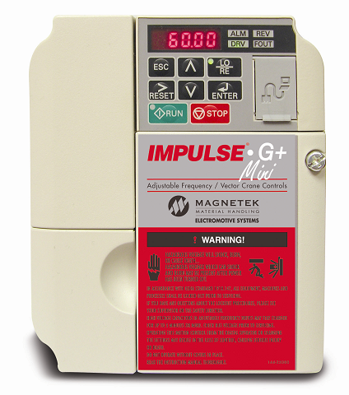
IMPULSE Drives
IMPULSE•G+ Mini Specifications
  Expanded HP range
    Identical dimensional footprint as the P3 Series 2 (up to 5HP)
    Smaller footprint beyond 5HP
  Factory default software settings for
  basic application programming
  Advanced programming capability
Notes:
The new IMPULSE•G+ Mini from Magnetek continues our history of providing the most reliable and cost-effective adjustable frequency crane controls available.
The low horsepower (HP) IMPULSE•G+ Mini is our easiest to program drive to date, with user-friendly standard programming for Basic applications and advanced programming capability for high performance environments. The IMPULSE•G+ Mini is designed with an expanded HP range and an identical dimensional footprint as the IMPULSE®•P3 Series 2 (up to 5HP) and a smaller footprint beyond 5HP.
Factory Default Software Settings – The IMPULSE•G+ Mini is factory preset for basic crane motion application programming using the “Basic Mode” programming level. This allows a technician to easily navigate and program the drive via a built-in keypad display in minutes for most applications. In the Basic mode the parameter availability (features) and navigation is nearly identical to the old IMPULSE•P3 Series 2.
Advanced Programming Capability – The IMPULSE•G+ Mini provides the option of an “Advanced” level. In the Advanced access level the parameter groups allow full access to all available features for the full programming capability the IMPULSE•G+ Mini drive has to offer. In this modes navigating will be identical to the familiar parameters of the IMPULSE•G+ Series 3 / 4 drives.

Slide 61
IMPULSE Drives
IMPULSE•G+ Mini Specifications
  Standard 120VAC interface card, 24VAC optional
  Ratings:
    ½ through 20 HP in 380-480V
    ¼ through 20HP in 200-240V
  Optional flat heat sink design available
Notes:
Compact Design – Our most compact low HP drive to date, the IMPULSE•G+ Mini’s size permits the use of smaller control enclosures, reducing the overall cost of an installation. It also expands application opportunities on smaller cranes, hoists, trolleys and monorail carriers. The IMPULSE•G+ Mini is available with standard 120VAC interface card, with 24VAC optional.
Expanded HP Range – Available in ½ through 20 HP in 380-480V or ¼ through 20HP in 200-240V 3 phase ratings. This allows the user to select the most cost-effective product for low HP applications through Class D service. Variable Frequency Drive (VFD) technology provides energy savings compared to traditional contactor technology.
Optional Flat Heat Sink Design Available – This option reduces the depth of the drive by as much as 45%. Finless capacities are available in 230-460V ½ through 5HP. Consult factory on the suitability of the flat heat sink design for your application.
IMPULSE•G+ Mini can also be purchased as part of a complete pre-engineered motor control system.

Slide 62
IMPULSE Drives
IMPULSE•G+ Mini Basic Control Mode
  CMAA class A-D service
  Exclusive crane & hoist software
  Removable terminal block with parameter backup
  40:1 speed range
Notes:
In the Basic Control mode level, the parameter availability (features) and navigation is nearly identical to the IMPULSE•P3 Series 2 in Basic mode.
Capabilities
CMAA Class A-D Service
Exclusive Crane & Hoist Software
Removable Terminal Block with Parameter Backup and:
(7) Multi-function digital inputs
120VAC standard (24VAC and 24VDC optional)
(1) Hardware BaseBlock
(2) Multi-function analog inputs (0-10VDC, 4-20mA, 0-20mA)
(1) Multi-function Pulse input
(1) Multi-function Pulse output
(1) Multi-function Relay output
(2) Multi-function photo-coupler output (120V optional)
Multi-function analog output (0-10VDC)
40:1 Speed Range
Three Speed Control Methods
Up to 5 distinct speeds
Infinitely Variable Control
Stepless Analog Speed Reference
Certifications: CE, UL, cUL, RoHs, TÜV
UL recognized Electronic Thermal Overload

Slide 63
IMPULSE Drives
IMPULSE•G+ Mini Basic Control Mode
  Safety Features
    Safe Operating Windows™
    Motor Thermal Overload Protection
    Quick Stop™
    EN954-1 Safety Category 3, Stop
    Category 0
Notes:
Safety
Safe Operating Windows™ - reduces possibility of programming unsafe parameters
Motor Thermal Overload Protection - reduces possibility of motor damage
Quick Stop™ - reduces possibility of crane collision
EN954-1 Safety Category 3, Stop Category 0 - Hardware Base Block circuit

Slide 64
IMPULSE Drives
IMPULSE•G+ Mini Basic Control Mode
  Performance Features
    X-Press Programming™
    Swift-Lift™
    Reverse Plug Simulation™
    40:1 Speed Range
Notes:
Performance
X-Press Programming™ - allows programming initial setup within seconds
Swift-Lift™ - allows overspeeding with light loads or empty hook
Reverse Plug Simulation™ - allows operator to smoothly and quickly stop and change directions
without setting brake
Auto-Tuning - non-rotational auto-tuning for performance demanding applications

Slide 65
IMPULSE Drives
IMPULSE•G+ Mini Advanced Control Mode
  All the Basic Mode Features, plus
    100:1 Speed Range
    200% Starting torque at 0.5Hz
    Up to 16 Discrete Speed References
    Expanded Programmable Input / Output
    Capabilities
    Preferred Parameter feature
    Pre-maintenance function (IGBTs, Capacitors,
    FAN)
Notes:
The IMPULSE•G+ Mini advanced control mode offers you our entire Basic control mode features, plus, with a single parameter access level adjustment, it can be opened up to utilize all the advanced features and programming capabilities without reconfiguring.
Capabilities
100:1 Speed Range
200% Starting torque at 0.5Hz
Up to 16 Discrete Speed References
Expanded Programmable Input/Output Capabilities
Preferred Parameter feature
Ingenious pre-maintenance function (IGBTs, Capacitors, FAN)
Side-by-side installation for panel space savings
Additional analog input available

Slide 66
IMPULSE Drives
IMPULSE•G+ Mini Advanced Control Mode
  Performance Features
    Open-Loop “Vector” Control
    Micro-Positioning™ Control
    Serial Communications
    Load Check II™
    Inching Control
    Auto-Tuning
Notes:
Performance
Open-Loop Vector Control
Micro-Positioning™ Control
Serial Communications - Modbus, RS-422/485 communication up to 115Kbps
Load Check II ™
Inching Control
Auto-Tuning - rotational and non-rotational auto-tuning for performance demanding applications

Slide 67
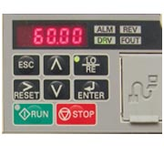
IMPULSE Drives
IMPULSE•G+ Mini Keypad/Digital Display
  Based on G+/VG+ parameter groups
  Easy to read LED 5 digit display
  Program both Basic and Advanced drive parameters
  Monitor the functions of the drive
  Read alpha-numeric fault diagnostic indications
Notes:
The IMPULSE®•G+ Mini’s keypad features an easy to read LED 5 digit display of parameters and diagnostics.
Its simplified navigation is common to IMPULSE® drives, so users don’t have to relearn. The keypad is easy to set up and use for troubleshooting.
Allows for:
Programming both Basic and Advanced drive parameters
Monitoring the functions of the drive
Reading alpha-numeric fault diagnostic indications

Slide 68
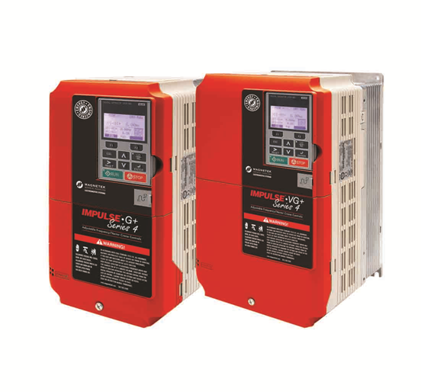
IMPULSE Drives
IMPULSE•G+/VG+ Series 4 Drives
Notes:
IMPULSE G+ and VG+ Series 4 drives

Slide 69
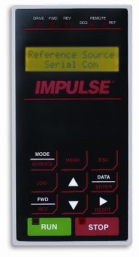
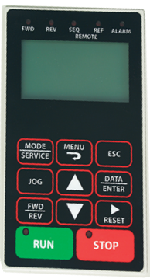
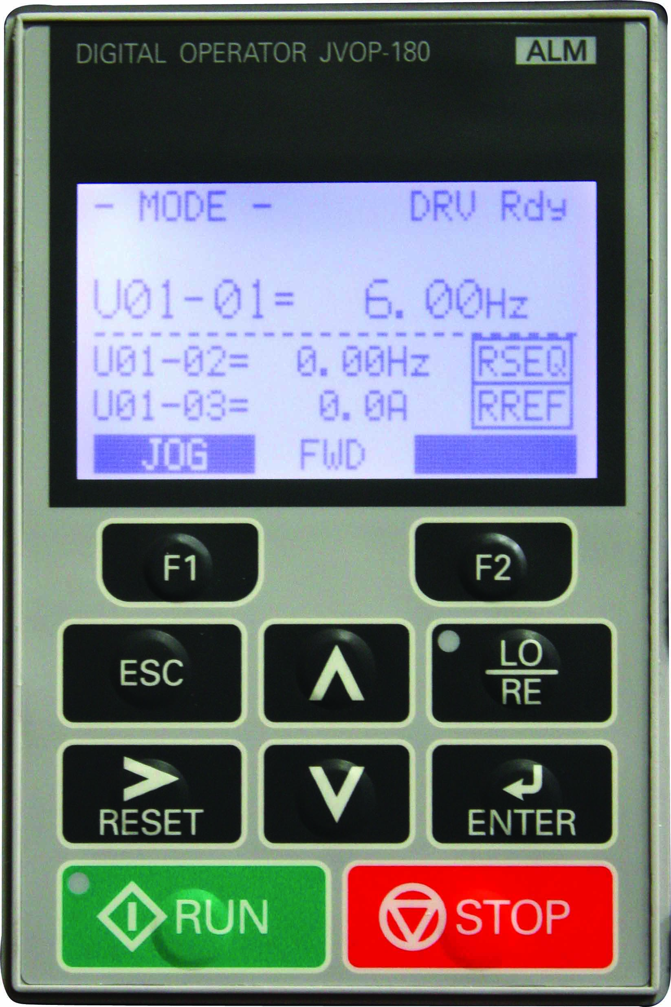
IMPULSE Drives
IMPULSE•G+/ VG+ Series 4 Keypad Enhancements
Series 2 keypad 2-16 Character Lines
Series 3 keypad 5-16 Character Lines
  Series 4 keypad 5-Many Character Lines

Slide 70
IMPULSE Drives
IMPULSE•G+/VG+ Series 4 Drives Programming
  Simple access to all parameters, no toggling between parameter types
  Programming parameters in series 4 shows the factory default as a separate line included with programmed parameter setting
Notes:
Description of the basic operation of Series 4 keypad

Slide 71
IMPULSE Drives
IMPULSE•G+/VG+ Series 4 Drives Options
  Cooling fan operation select
    Continuous operation
    Timed operation – programmable time delay for cooling fan shut-off after drive operation
  Maintenance timer – can be
  programmed to provide
  maintenance clock
  Fault history storage – will store
  last 10 fault events with time
Notes:
IMPULSE G+VG+ Series 4 popular options

Slide 72
IMPULSE Drives
IMPULSE•G+/VG+ Series 4 Drives Custom Software
  Swing Control Series 2 (SCS-S2) (G+)
  Footbrake/Static Stepless Simulation Software (VG+)
  Hoist / Drive Synchronization Software (VG+)
  Clamshell / Grab Bucket Software (VG+)
Notes:
Magnetek offers additional “Custom Software” for unique overhead crane applications

Slide 73
IMPULSE Drives
IMPULSE•G+/VG+ Series 4 Drives Support Tools
  IMPULSE•Link Basic 4.1 – up load / down load software with drive monitoring
  IMPULSE•Link WDS – wireless up load / down load software with drive monitoring
  DataLogger® Series 3+ diagnostic device to monitor status including run commands, alarm codes and fault codes, is compatible with IMPULSE Series 4/3/2 Drives
Notes:
Magnetek support tools designed for use with the IMPULSE drive platforms

Slide 74
IMPULSE Drives
IMPULSE•G+/VG+ Series 4 Drives Serial Communication Options
  All Series 4 drives are compatible with the following serial protocols
    DeviceNet with ADR
    EtherNet /IP
    Modbus TCP / IP
    Profibus- DP
Notes:
IMPULSE G+/VG+ Series 4 drive platforms have serial communication options with additional expansion boards installed on drives

Slide 75
IMPULSE Drives
IMPULSE•G+/VG+ Series 4 Drives
  Ratings
    230V Series, 1-150 HP (3.2-415 AMP)
    460V Series, 1-500 HP (1.8-605 AMP)
    575V Series, 1-200 HP (1.7-200 AMP)
  S4IF-12-A60 20V AC Interface
  Built-in Dynamic Braking Transistor in drive sizes up to
    230VAC – 115 Amp
    460VAC - 60 Amp
    575VAC - 41 Amp
Notes:
IMPULSE G+/VG+ Series 4
The IMPULSE G+/VG+ Series 4 is available in 1-150 HP (3.2 – 415 Amp) in 230VAC , 1-500 Hp (1.8–605 Amp) in 460VAC and 1 – 200Hp (1.7-200 Amp) in 575 VAC.
Large HP/Current ratings are available
Internal dynamic braking transistor is included in drive models: 2003 - 2115-G+S4 (230VAC), 4001 – 4060-G+S4 (460VAC), 5001 – 5041-G+S4 (575VAC) NOTE use of the internal dynamic braking transistor will depend on CMAA duty cycle application
The 120V Control Voltage Interface Card allows direct access via 120V user input device (e.g. pendant) without adding electro-mechanical components. Other control voltages are available.

Slide 76
IMPULSE Drives
IMPULSE•G+/VG+ Series 4 Drives
  Three programmable digital outputs are standard
  Six programmable digital inputs
    Additional four inputs with optional card (S4I-120A60)
  Three programmable analog inputs
  Two programmable analog outputs
Notes:
IMPULSE G+/VG+ Series 4 I-O
Six 120VAC programmable digital inputs are standard, and 4 additional inputs with an optional S4I-120A60 board.
Three programmable analog inputs and two programmable analog outputs are standard.

Slide 77
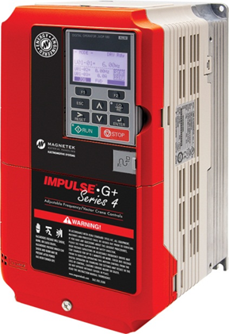
IMPULSE Drives
IMPULSE•G+ Series 4 Drives
  Built-In Auto-Tuning (Open Loop Vector)
  X-Press Programming™
  Safe Operating Windows™
  Quick Setting
  Multiple Speed Control Methods
  Keypad Copy Function
  Load Check II™
Notes:
IMPULSE•G+ Series 4
Built-in Auto-Tuning precisely determines the motor parameters and stores them in memory for accurate and effective operation.
Two Modes: 1. “Standard” Tuning (Motor Rotates) and 2. “Tune No Rotate”
X-Press Programming (A1-XX group) simplifying the programming process, allows the setting of parameters to be entered with a minimum of keystrokes.
Quick Setting (A2-XX group) automatically populated group of parameters that are “typically” changed for drive mode type, motion, speed control method to further simplifying the programming .
Multiple Speed Control Settings allows for any combination of digital / analog / serial control
Safe Operating Windows prevents operators from programming the drive with unsafe values to avoid situations where a crane may not be able to lift a load or stop within a safe distance.
Load Check II option allows IMPULSE•G+ Series 4 to be programmed so that operators cannot overstress equipment by attempting to lift a load beyond the capacity of the hoist.

Slide 78
IMPULSE Drives
IMPULSE•G+ Series 4 Software Features
Brake Set Delay Timers
Torque Proving at Start
Swift Lift™
Inching Control
Slip Compensation
Stall Prevention
Alternate Acceleration/
Deceleration
Micro-Positioning Control™
Built-In Auto-Tuning
ISO/EN13849-1 Safe Torque Off
Notes:
IMPULSE•G+ Series 4
Brake Set, via software, delays brake setting time (used on traverse motions to center the trolley or bridge over the load).
Torque Proving at Start can be programmed so the brake will not release unless full torque is being output by the drive.
Swift Lift enhances productivity by quickly moving loads into position under no-load or light-load conditions.
Inching Control allows very accurate load positioning in increments with virtually no potential operator error.
Slip Compensation ensures speed regulation in both hoisting directions. For traverse applications, this function maintains constant motor speed regardless of the load.
Stall Prevention prevents the motor’s current limits from being exceeded by extending the acceleration and deceleration times, or decreasing the frequency.
Alternate Deceleration allows smooth, uninterrupted deceleration from fast speeds if a second accel/decel is required.
Micro-Positioning allows an operator to make very precise, slow moves and aids in the spotting of heavy loads.
Auto-Tune allows IMPULSE G+ Series 4 to accurately determine required motor torques for Open Loop Vector control.
Micro-Positioning allows an operator to make very precise, slow moves and aids in the spotting of heavy loads.
ISO/EN13849-1 Safe Torque Off includes safe off disable inputs and safe monitor outputs

Slide 79
IMPULSE Drives
IMPULSE•G+ Series 4 Software Features
  Quick Stop™
  Reverse Plug Simulation™
  Multi-Level Password
  Motor Thermal Overload Protection
  Motor Phase Loss Detection
  Ground Fault Protection
Notes:
IMPULSE•G+ Series 4
Quick Stop ensures a rapid deceleration to stop once a drive “run” command is removed, reducing the possibility of a crane collision.
Reverse Plug Simulation allows an operator to change direction of travel very rapidly for positioning flexibility.
Multi-level password protection limits programming access and reduces the possibility of programming errors.
Motor thermal overload protection continuously monitors output current and shuts off power if excessive current is sent to the motor.
Phase loss detection causes the drive to fault and commands the brake to set if an input or output phase loss occurs.
Ground fault protection detects a higher current output via DCC’s on one of the output legs.

Slide 80
IMPULSE Drive
IMPULSE•G+ Series 4 Software Features
  Overload/Load Check Counter
  Number of Operations Counter
  Short Circuit Protection
  Built-In Serial Option
  Fault history and trace data via ROM
  Elapsed Run Timer
  Maintenance Timer
Notes:
IMPULSE•G+ Series 4
The Overload/Load Check Counter records the number of times the drive goes into the Over Load or Load Check feature.
The IMPULSE•G+ Series 4 maintains a count of the number of run commands issued to in the Operations Counter to assist in the scheduled maintenance of the drive.
Built-in serial communication provides reliable digital linkage with Magnetek XTLX radio remote crane controls (transmitter has LCD screen to read feedback from IMPULSE drive(s)) and other Magnetek designed controls.
Flash ROM memory allows fault history to be stored in the drive’s memory for diagnostic purposes. If the control is powered down for troubleshooting, the fault history will be saved.
Elapsed Time Counter (with fault history) indicates actual operation time, total power-up time, elapsed time between fault occurrences and the number of “run” commands.
Maintenance Timer automatically shuts down IMPULSE drive with a unique fault and can be used as an alert that the crane or individual crane motion is in need of maintenance

Slide 81

IMPULSE Drives
IMPULSE•G+ Series 4 Custom Software
  Sway Control System (SCS®) Series 2
Notes:
A Sway Control System is available using Series 4 drives. An IMPULSE VG+ Series 4 drive must be used on the hoist, information from the VG+S4 is sent to IMPUSLE G+ Series 4 trolley and bridge motion controls resulting in control of load swing

Slide 82
IMPULSE Drives
IMPULSE•G+ Series 4 Optional Communications
  All Series 4 drives offer optional wireless communication IMPULSE•Link WDS for up to 31 drives (nodes) which can provide
    Drive Operation Monitoring
    Drive Diagnostics
    Drive Programming
Notes:
IMPULSE Link WDS provides the ability for trouble shooting from remote locations

Slide 83
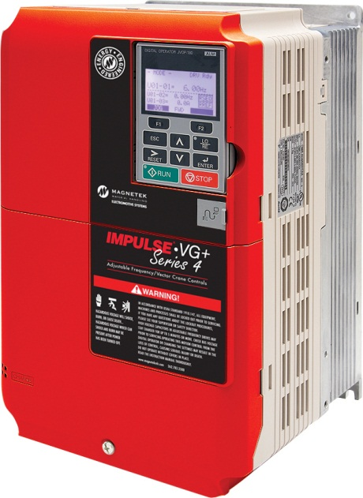
IMPULSE Drives
IMPULSE•VG+ Series 4
  Latest Generation IGBTs
  CMAA Class A through F
  Up to 1500:1 – “Closed Loop” Vector Control
  Keypad w/English Display
Notes:
IMPULSE•VG+ Series 4
IMPULSE•VG+ Series 4 crane controls feature a state-of-the-art power platform (IGBTs) and 32-bit microprocessor making it a faster and more powerful unit.
IMPULSE•VG+ Series 4 crane controls may be used for traverse motions on top running and under running floor-controlled and cab-controlled bridges and trolleys; monorail carriers; transfer cars; etc. for CMAA Class A through CMAA Class F service.
IMPULSE•VG+ Series 4 crane controls may be used for mechanical load brake hoists and worm gear hoists; for CMAA Class A through CMAA Class F (HMI Class H1 through H5) service.
IMPULSE•VG+ Series 4 crane controls operate in closed loop vector mode and will provide a control range of 1500:1 when used with a suitable low slip motor and when the Auto Tune function has been successfully completed
An English, plain-language liquid crystal display makes programming, troubleshooting and operating the drive easy.

Slide 84

IMPULSE Drives
IMPULSE•VG+ Series 4
  Built-in Auto-Tuning
  X-Press Programming™
  Safe Operating Windows™
  Multiple Speed Control Methods
  Keypad Copy Function
  Load Check II™
  Brake Answer Back
Notes:
IMPULSE•VG+ Series 4
Built-in Auto-Tuning precisely determines the motor parameters and stores them in memory for accurate and effective operation.
Simplifying the programming process, X-Press Programming allows the setting of parameters to be entered with a minimum of keystrokes.
Safe Operating Windows prevents operators from programming the drive with unsafe values to avoid situations where a crane may not be able to lift a load or stop within a safe distance.
Load Check software allows IMPULSE•VG+ Series 3 to be programmed so that operators cannot overstress equipment by attempting to lift a load beyond the capacity of the hoist.
An input terminal can be programmed to accept a brake answer back input which allows the user to monitor the brake contactor.

Slide 85
IMPULSE Drives
IMPULSE•VG+ Series 4 Software Features
  Brake Set Delay Timers
  Torque Proving at Start
  Ultra Lift™
  Slip Compensation
  Stall Prevention
  Alternate Acceleration/Deceleration
  Micro-Positioning Control™
  Built-In Auto-Tuning
Notes:
IMPULSE•VG+ Series 4
Brake Set Delay, via software, delays brake set time - in traverse motions to center the trolley or bridge over the load, in no load brake hoist motions used in conjunction with Load Float).
Torque Proving at Start can be programmed so the brake will not release unless full torque is being output by the drive.
Ultra Lift enhances productivity by quickly moving loads into position under no-load or light-load conditions.
Inching Control allows very accurate load positioning in increments, with virtually no potential operator error.
Slip Compensation maintains constant motor speed regardless of the load.
Stall Prevention prevents the motor’s current limits from being exceeded by extending the acceleration and deceleration times, or decreasing the frequency.
Alternate Deceleration allows smooth, uninterrupted deceleration from fast speeds if a second accel/decel is required.
Micro-Positioning allows an operator to make very precise, slow moves and aids in the spotting of heavy loads.

Slide 86
IMPULSE Drives
IMPULSE•VG+ Series 4 Software Features
  Motor Torque Proving at Start
  Roll Back Detection at Start
  Seized Brake Detection at Start
  Brake Proving at Stop
  Load Check II™
  Torque Limited Accel and Decel
  Built-In Auto-Tuning
Notes:
IMPULSE•VG+ Series 4
Motor Torque Proving at Start can be programmed so the brake will not release unless full torque is being output by the drive.
Roll Back Detection at Start detects and prevents any dropping of load at start when hoisting.
Seized Brake Protection at Start prevents undo damage that may be caused against attempting to drive through a brake that has not released or a bound-up gear box.
Brake Proving at Stop will detect a worn or slipping brake. The drive and motor will re-energize in this event and keep the load from dropping.
Load Check II option allows IMPULSE•VG+ Series 4 to be programmed so that operators cannot overstress equipment by attempting to lift a load beyond the capacity of the hoist.
Torque Limited Accel and Decel automatically changes acceleration and deceleration as the motor load changes.

Slide 87
IMPULSE Drives
IMPULSE•VG+ Series 4 Software Features
  Quick Stop™
  Reverse Plug Simulation™
  Multi-Level Password
  Motor Thermal Overload Protection
  Motor Phase Loss Detection
  Ground Fault Protection
  Slack Cable Protection
Notes:
IMPULSE•VG+ Series 4
Quick Stop ensures a rapid deceleration to stop once a drive “Run” command is removed, reducing the possibility of a crane collision.
Reverse Plug Simulation allows an operator to change direction of travel very rapidly for positioning flexibility.
Multi-level Password protection limits programming access and reduces the possibility of programming errors.
Motor Thermal Overload Protection continuously monitors output current and shuts off power if excessive current is sent to the motor.
Motor Phase Loss Detection causes the drive to fault and commands the brake to set if an input or output phase loss occurs.
Ground Fault Protection detects a higher current output via DCCs on one of the output legs.
Slack Cable Protection prevents the operator from un-spooling cable when the hook touches the bottom of travel.

Slide 88
IMPULSE Drives
IMPULSE•VG+ Series 4 Software Features
  Overload/Load Check Counter
  Number of Operations
  Short Circuit Protection
  Built-In Serial Communication
  Fault History and Trace Data via ROM
  Elapsed Run Timer
Notes:
IMPULSE VG+ Series 4
The Overload/Load Check Counter records the number of times the drive goes into the “Overload” or ”Load Check” feature.
The IMPULSE•VG+ Series 4 maintains the number of run commands issued to assist in the scheduled maintenance of the drive.
Built-in serial communication provides reliable digital linkage with Magnetek XTLX radio remote crane controls (transmitter has LCD screen to read feedback from IMPULSE drive(s)) and other Magnetek designed controls.
Flash ROM memory allows fault history to be stored in the drive’s memory for diagnostic purposes. If the control is powered down for troubleshooting, the fault history will be saved.
Elapsed Run Timer (with fault history) indicates actual operation time, total power-up time, elapsed time between fault occurrences and the number of “Run” commands.

Slide 89
IMPULSE Drives
IMPULSE•VG+ Series 4 Software Features
  Additional Standard Options
    Snapped Shaft / Drive Train Discontinuity Detection
    Indexing
    Load Sharing
    Electronic Programmable Limit Switches
    ISO/EN13849-1 Safe Torque Off
    Brake Test Function

Slide 90
IMPULSE Drives
Explanation of “Vector Control”
  Used with IMPULSE•G+ Mini / IMPULSE•G+ Series 4 and IMPULSE•VG+ Series 4
Notes:
The IMPULSE G+ Mini, IMPULSE G+ Series 4 have the option to be “Vector Control”
IMPULSE VG+ Series 4 drives is a dedicated “Vector Control”

Slide 91
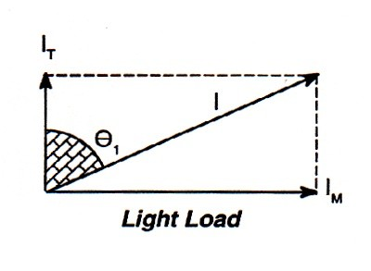
IMPULSE Drives
Vector Control Light Load
Notes:
IM = magnetizing current established by “AutoTune” function and remains a “constant” value once established AutoTune
IT = motor current that will change based on required torque demand on motor
I – will change base on combination of constant IM and change in IT

Slide 92
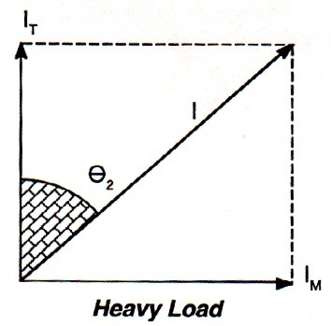
IMPULSE Drives
Vector Control Heavy Load
Notes:
IM = magnetizing current established by “AutoTune” function and remains a “constant” value once established AutoTune
IT = motor current that will change based on required torque demand on motor
I – will change base on combination of constant IM and change in IT

Slide 93
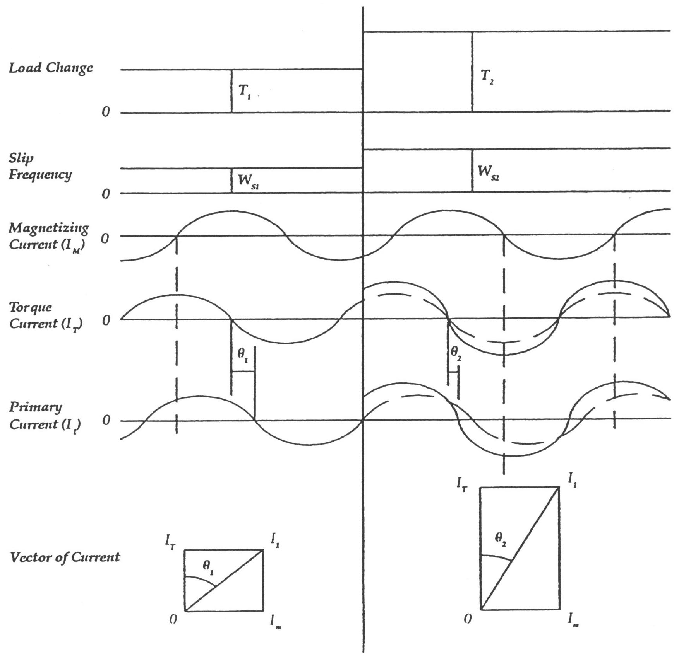
IMPULSE Drives
Vector Control Typical Representation

Slide 94
IMPULSE Drives
IMPULSE•VG+ Series 4
  Closed Loop Vector Mode of Operation
    Termed “Flux Vector” Control
    Closed Loop control via Encoder
    Speed Set Points with Torque Limit
    Determines Motor Slip
    Calculates Torque Demand
    Quick Response to Changes in Torque Demand
Notes:
Theory of Operation
A flux vector AC drive is a special type of adjustable frequency motor control, delivering new levels of performance and safety to AC motors– especially in overhead material handling applications.
Working in a closed-loop system, a flux vector motor control utilizes an incremental encoder to monitor the speed and direction of the motor shaft. This system also has a speed set point with a torque limit. When the drive is told to go a higher speed, it will attempt to achieve the speed set point which is limited only by the torque setting. Since the speed and direction of the motor shaft are always known (via the encoder), the flux vector control can determine the slip of the motor at any time.
Slip is the difference between the synchronous RPM of the motor and the RPM of the same motor with a load. As the load on an induction motor increases, the speed of the rotor decreases to produce more torque. Slip (difference in RPM) is also proportional to torque. So, the greater the torque demand on the motor shaft (rotor), the greater motor slip will be. Since the torque demand can be calculated, the flux vector drive can adjust both the frequency and voltage to produce the current required to maintain the torque level.
(continued on next page)

Slide 95
IMPULSE Drives
IMPULSE•VG+ Series 4
  Closed Loop Vector Mode of Operation
    Adjusts torque producing current without increasing magnetizing current
Notes:
Theory of Operation (continued)
Within safe limits programmed by the user, the flux vector drive calculates and adjusts very quickly so the motor cannot go beyond the control capabilities of the drive.
Current to the motor has two components: the magnetizing component, and the torque producing component. These components can be represented as vectors that are 90° apart. The vector sum of these components gives the required motor current magnitude and phase angle. The result of summing the vectors is the amplitude of current into the motor. With an increased torque demand, the torque producing current amplitude must increase to meet the torque demand. Since the flux vector drive monitors motor current, it can produce current at the correct amplitude, frequency and phase angle to respond to the increases in load torque. Since it calculates the correct phase and amplitude angle very quickly, only enough current is produced to offset the increase in torque demand–without producing additional magnetization current, which would result in increased motor heating.

Slide 96
IMPULSE Drives
IMPULSE•VG+ Series 4
  Closed Loop Vector Mode of Operation
    Heavy duty industrial type
    Output resolution – 1,024 pulses per revolution
    12V DC differential line driver output
    Connected to motor shaft to provide zero backlash
    Shielded cable
Notes:
Encoder Specifications
Encoder is to be a heavy duty industrial type incremental shaft encoder with Quadrature line driver output.
Required output resolution is to be 1,024 pulses per revolution.
Prefer a 12V DC Differential Line driver output. Consult factory for others.
Output signal is to be Quadrature (A+B) for direction detection.
Encoder must be connected to the motor shaft with direct coupling or direct shaft mounting that has zero backlash.
Customer supplied shielded cable is to be continuous, without splice, from the encoder back to the IMPULSE•VG+ drive. Shielded cable is to be 6 conductor, 3 twisted pair shielded, 24/16 AWG (Belden 9730or equivalent).

Slide 97
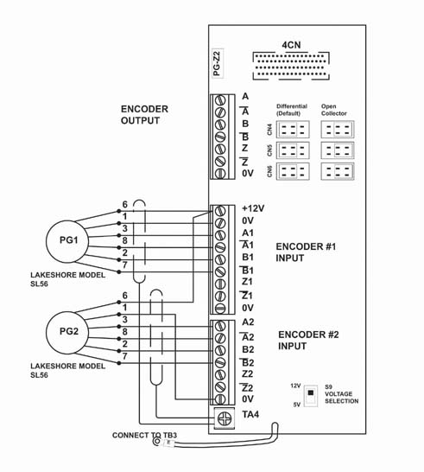
IMPULSE Drives
Notes:
IMPULSE VG+ Series 3 encoder interface board options:
PG-Z2 - encoder interface board used on IMPULSE•VG+ Series 3 drives with the optional “Hoist Sync” or “Snapped Shaft “ operations as well as other applications requiring dual encoder signal inputs, this board replaces the PG-W2 on IMPULSE•VG+ Series 2 drives.

Slide 98
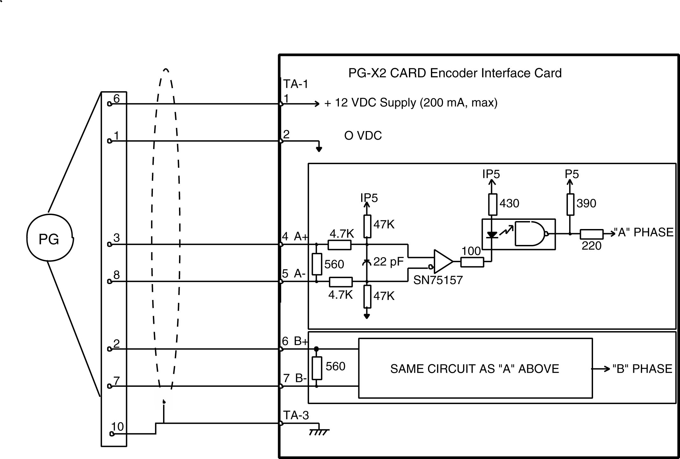
IMPULSE Drives
Encoder Interface Board Circuitry
PG-T2 CARD Encoder Interface Card
Notes:
Diagram shows encoder interface board circuitry from a PG-X card used on IMPULSE VG+ Series 2 drives

Slide 99
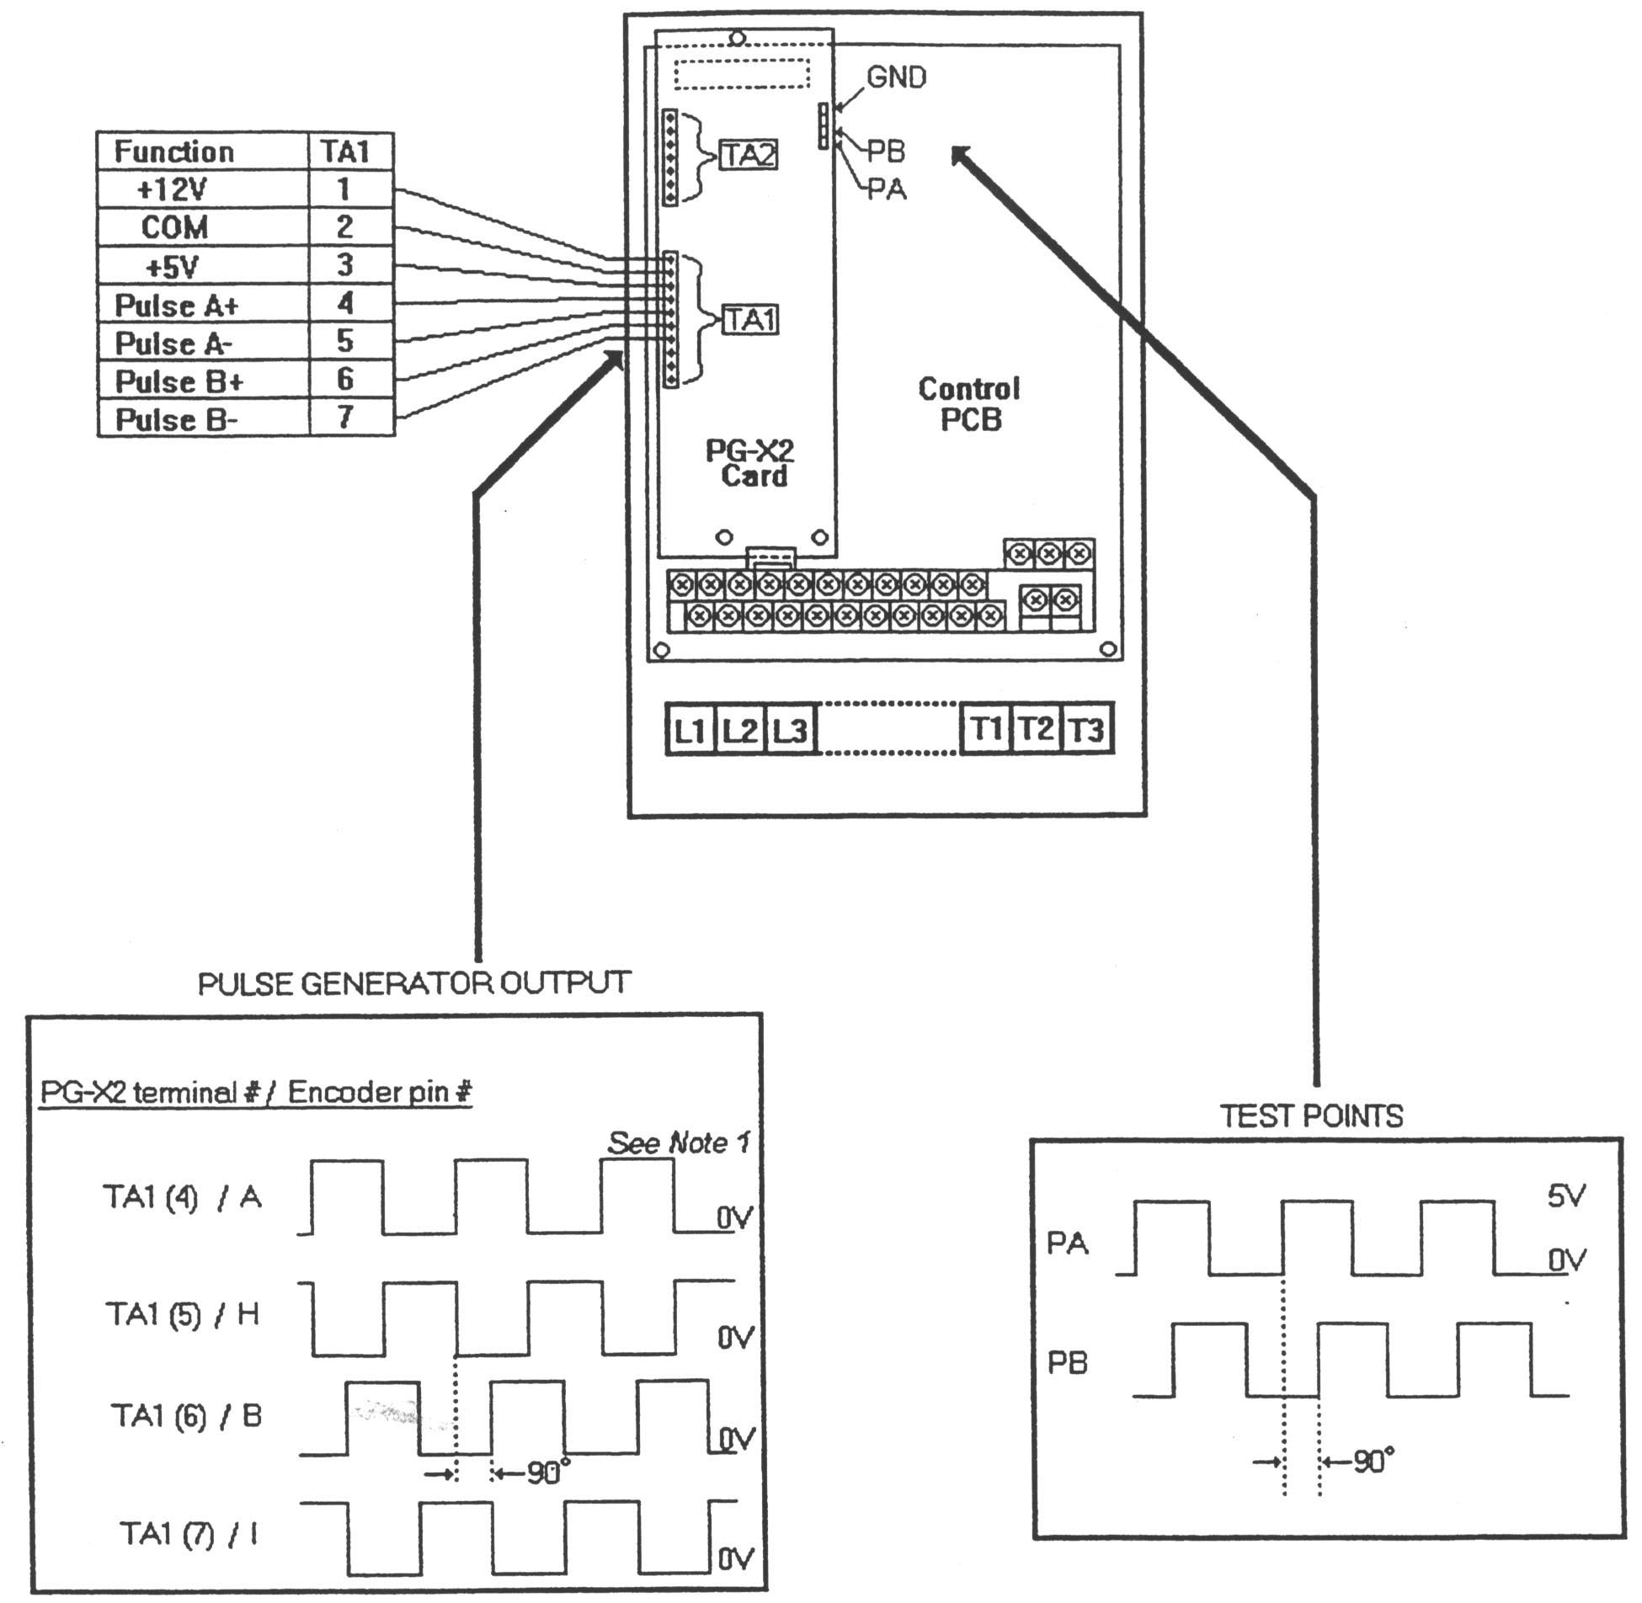
IMPULSE Drives
Notes:
Test points from PG-X2 board used the VG+ Series 3 with single encoder feedback.

Slide 100
IMPULSE Drives
Notes:
Terminal connections of PG-X3 encoder interface board used with IMPUSLE VG+ Series 4 drives

Slide 101
IMPULSE Drives
Notes:
Block diagram of PG-X3 internal circuitry with test points

Slide 102
IMPULSE Drives
IMPULSE•VG+ Series 4 Start-Up Procedure
  Initial Inspection
  Check Programming Parameters
  Check Encoder Connections
  Confirm Rotation of Motor
  Auto Tune Motor
  Take No-Load Reading
  Load Test
  Check Brake Proving
  Save Parameters
Notes:
Start-Up Procedure
Initial Inspection
Make a visual inspection of the panel including wiring and drive connections before power-up. If the power has already been applied, check for any unusual heating or coloring of wires or components.
Check Programming Parameters
Confirm parameter setting match application. Change any parameters that are incorrect and check for special functions that may not have been turned on in initial testing (i.e. Load Check, Ultra Lift, Micro Speed, etc.). Confirm that parameters are suitable for the application.
Check Encoder Signal/Confirm Motor Rotation
Observe the encoder signal with VOM meter or an oscilloscope. Results of “processed” encoder signal can be viewed in monitor mode parameter U1-05 Signal measurements should be made on the PG-X2 card. Measure A and B. If any noise is seen, check to make sure that the encoder cable shield is connected to terminal TA4 on the PG-T2 / PG-Z2 encoder interface board only.
Auto Tune Motor
An Auto Tune must be performed with the motor being controlled by the IMPULSE VG+ Series 3 drive. If the Auto Tune has not been successfully completed, the brake proving functions and motor torque related functions probably will not work.
(continued on next page)

Slide 103
IMPULSE Drives
IMPULSE•VG+ Series 4 Start-Up Procedure
  Customer Approval
  Final Constant Upload
Notes:
Start-Up Procedure (continued)
Observe Motor Torque Under No-Load Conditions
With no load on hoist, run the hoist up and down at various speeds and observe motor torque under U1-09. Confirm motor torque levels are reasonable for application.
Load Test
The drive should now be ready for load testing. In most cases, the end user will want to test for 125% load lifting capability. In some cases, the load lifting capability test should be 100%. Insist on at least a 50% load test in order to tell whether or not the drive is working correctly.
The same type of current and torque measurements that were taken during no-load should be taken at full load. Current readings should be close to motor FLA if 100% at load and torque readings should correspond to the percent of load that is being lifted.

Slide 104
IMPULSE Drives
Thank you for your time this week!
Notes:
Thank-you

